Slide 1
Structural and Decorative Design

Slide 2
Design
Is the Selecting and organizing of materials to fill a function.

Slide 3
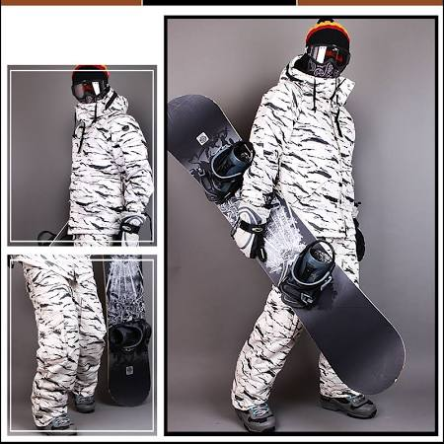
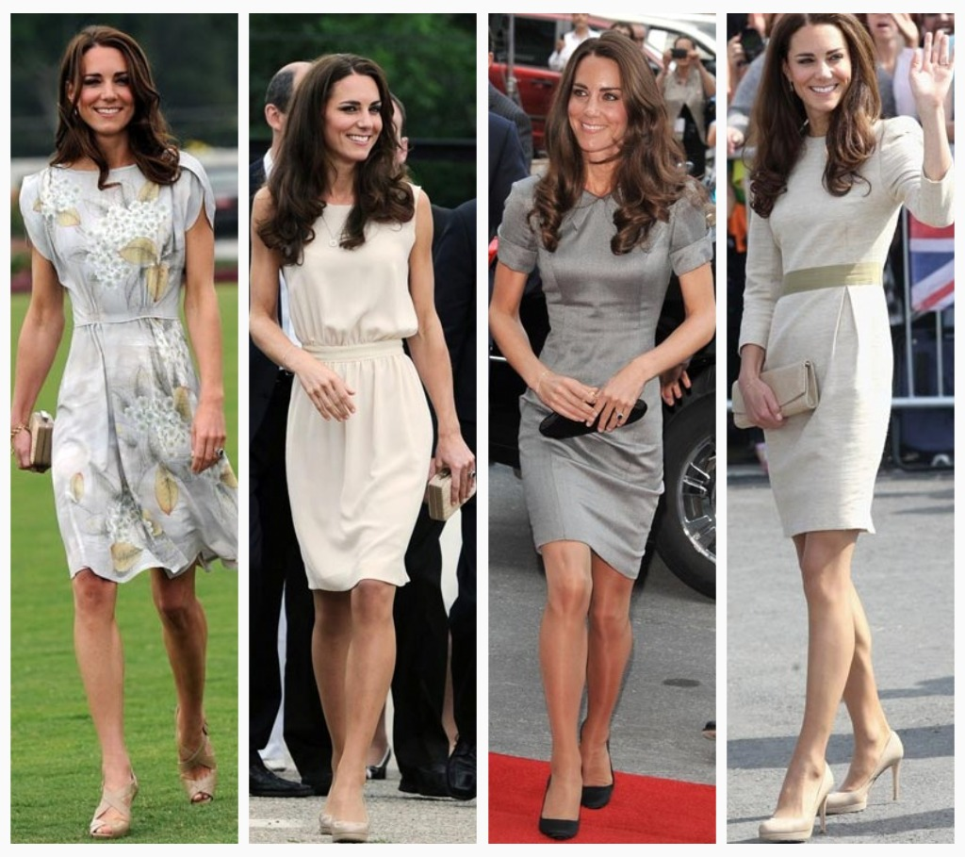
Function
What purpose will the object serve.

Slide 4
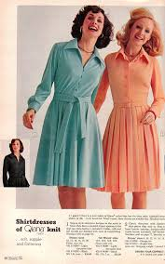
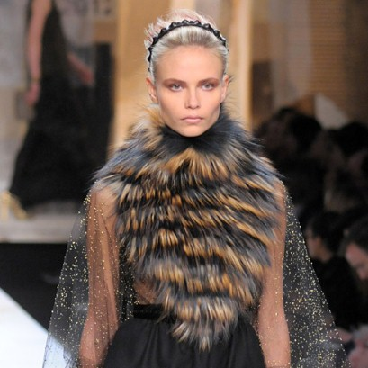
Materials
What will the object be made of?

Slide 5
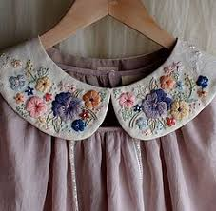
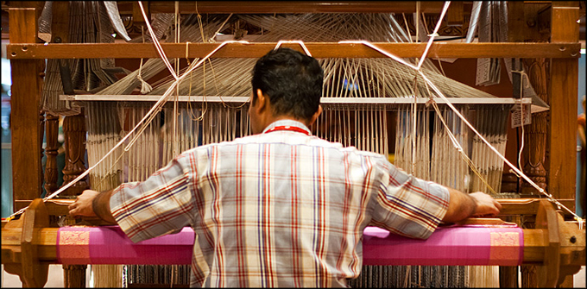
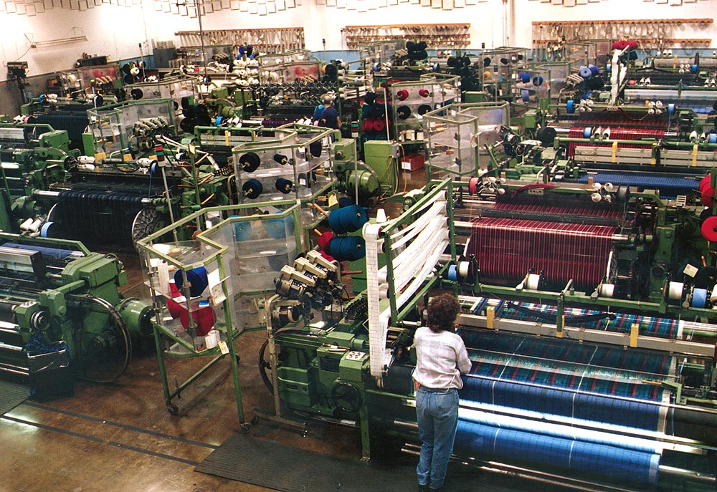
Technology
How will the object be made?

Slide 6
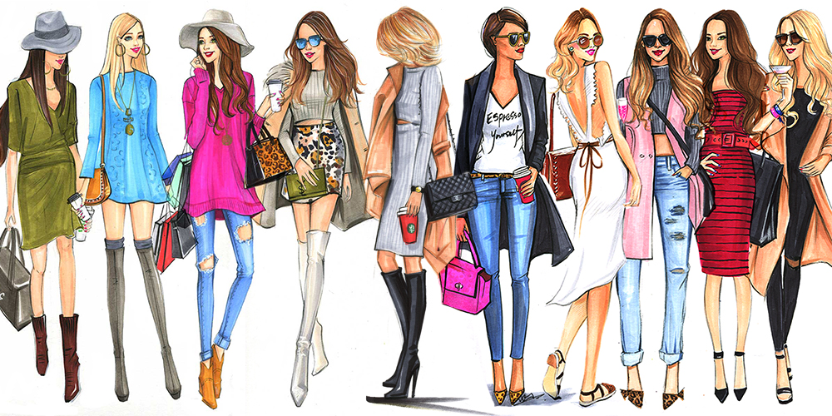
Style
Is the object appropriate and appealing to the user?

Slide 7
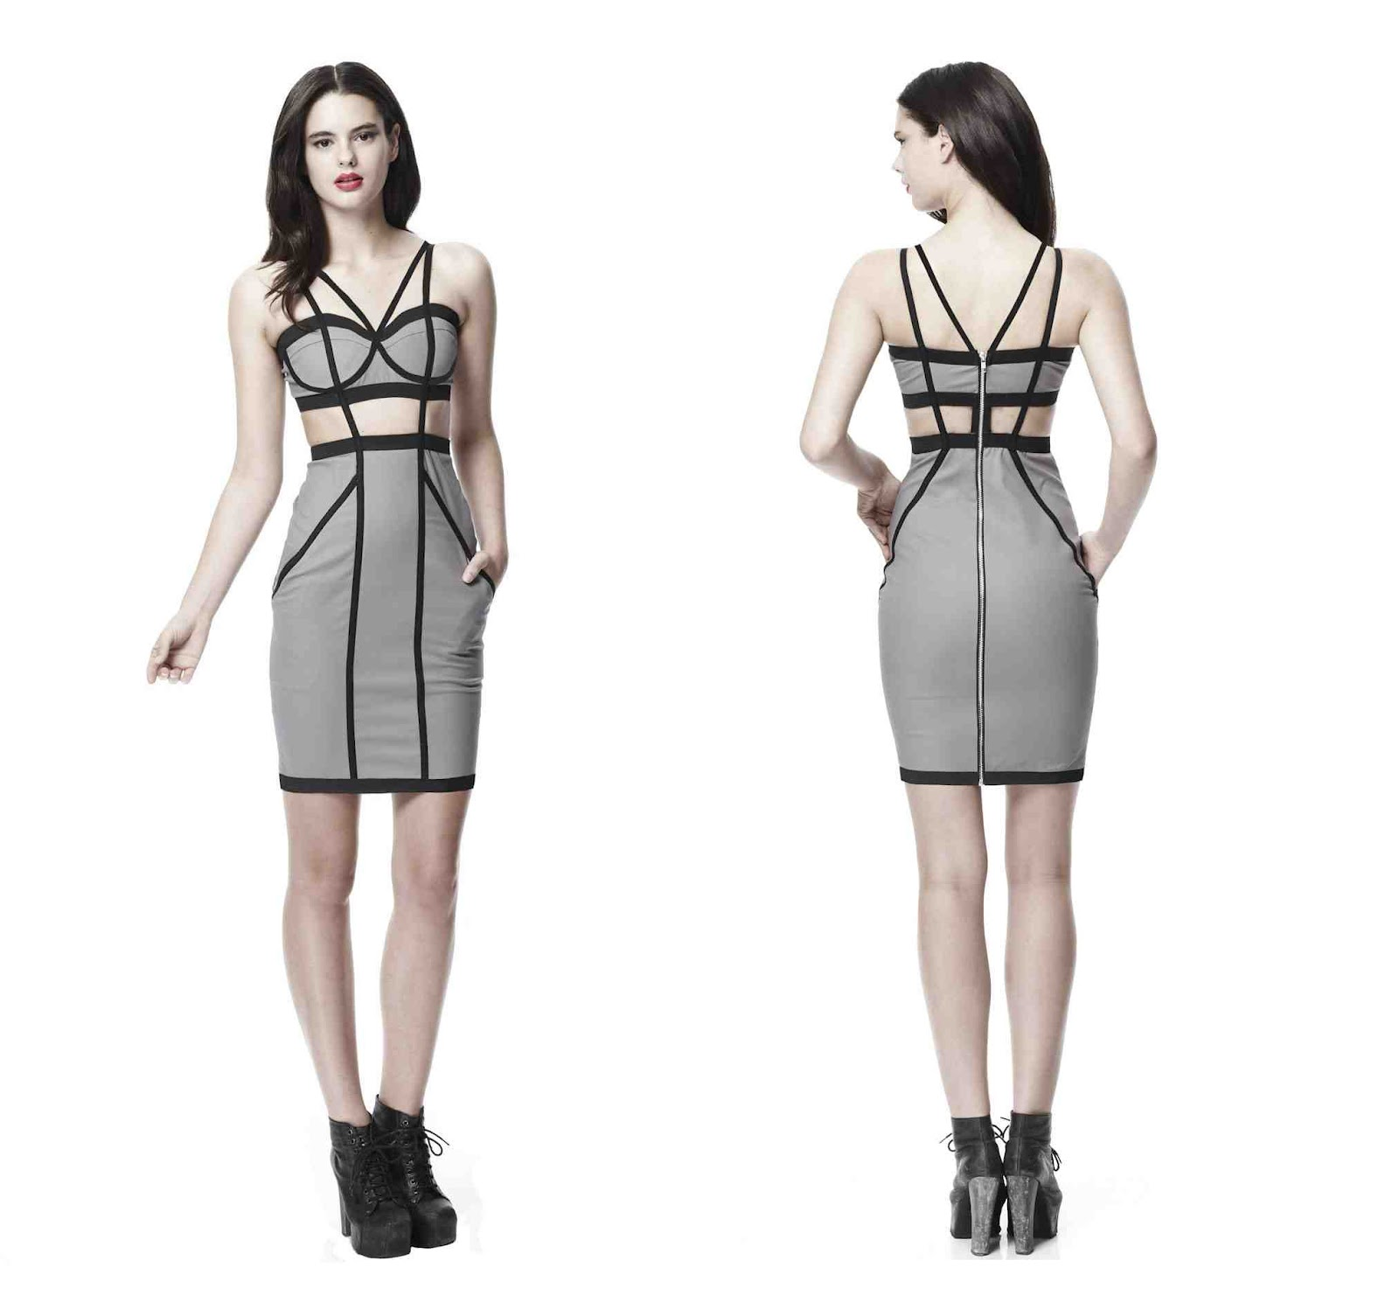
Structural design is:
The design is an integral part of the structure itself.
The Structure and the design cannot be separated.
The simplest form of design

Slide 8
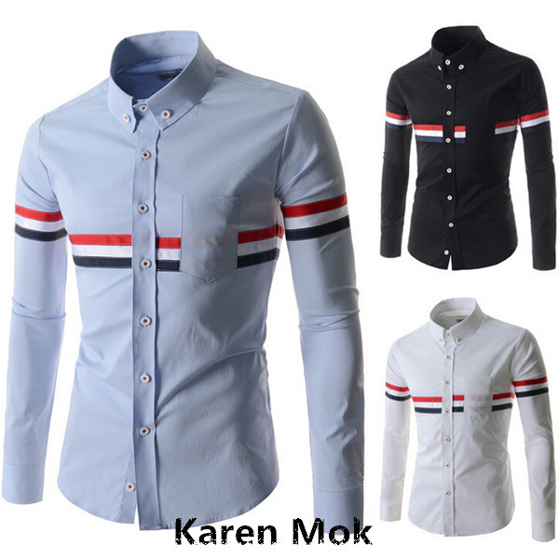
Decorative design is:
Involves the application of color, line, texture, or pattern to an object
Ornamentation added to the basic form.

Slide 9
Guidelines for decorative design
Ornamentation should be suitable for the intended use of the item.
The object should be useable and functional.
Embellishment should emphasize structural points.
Decoration should be appropriate in size and amount to the object on which it is found.

Slide 10
Four types of decorative design
Naturalistic: reproductions of natural subjects.
Stylized: A representation that simplified version of nature.
Abstract: unrecognizable as a specific object or thing.
Geometric: a design made with the use of Stripes, Plaid and geometric shapes.

Slide 11
The Rule
The form of an object or space should reflect its intended use and fulfill its intended function.
The first priority in design is it’s function, which dictates the shape or form of a design.
“Form Follows Function”

Slide 12
Functional Design?
Are they functional or nonfunctional?
pink card is functional
Blue card is non functional

