Slide 1
Element of Design
The tools of design
Hands on - can be manipulated
Line
Form and shape
Space
Texture
Color
Pattern

Slide 2
Line is:
The connection of two points.
The Element in a room that moves the eye from one point to another.

Slide 3
Line
1. Vertical
2. Horizontal
3. Curved
4. Diagonal
horizontal
vertical
Curved
diagonal

Slide 4
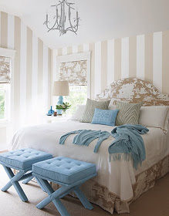
Vertical Line
Lends dignity and formality
Creates feelings of aspiration and ascension.
Leads the eye up.
A feeling of height and strength.

Slide 5
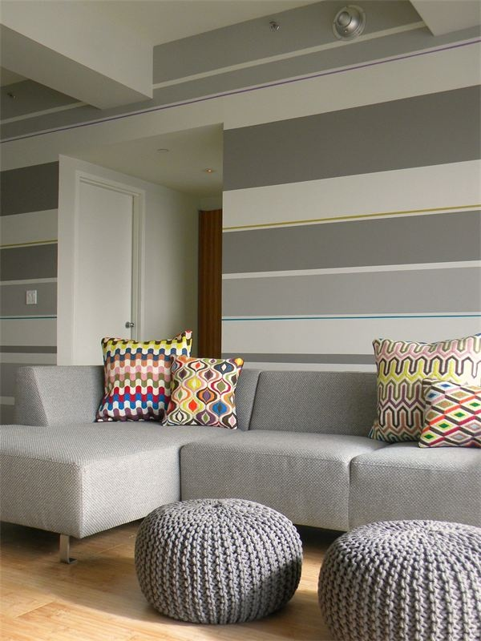
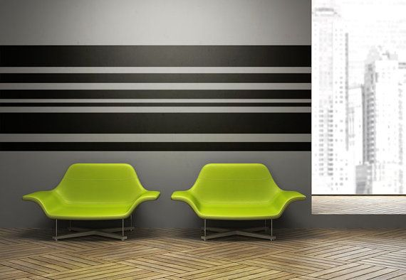
Horizontal Line
Restful
Relaxing
Informal
Casual
Comfortable

Slide 6
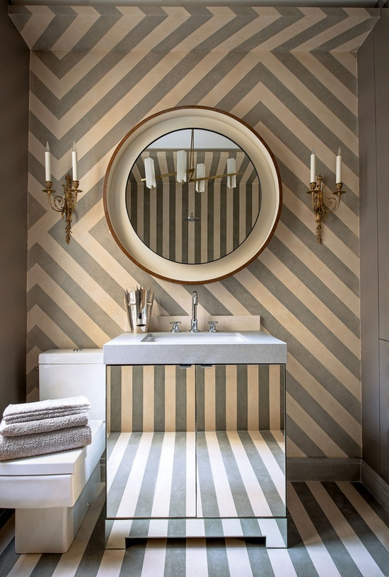
Diagonal Line
Active
Suggests movement
Excitement
Energy
Direction

Slide 7
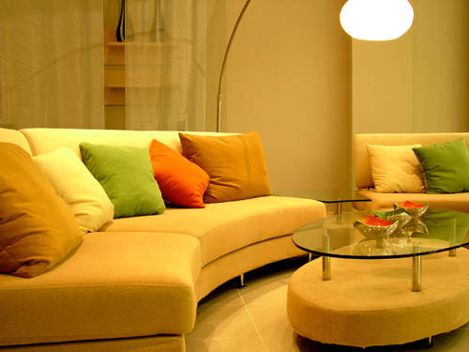
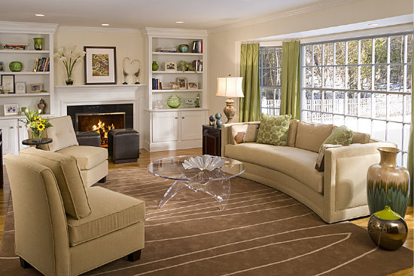
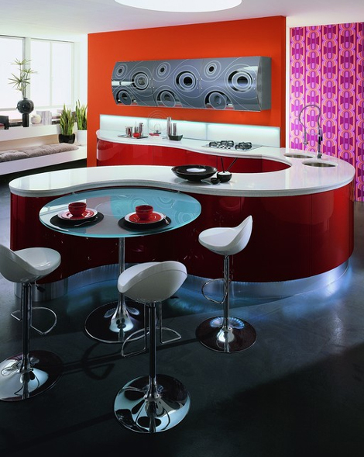
Curved Line
Graceful
Feminine
Delicate
Gentle

Slide 8
what type of line do you see?
Arm gesture to show the line seen in each room.

Slide 9
What type of line do you see?

Slide 10
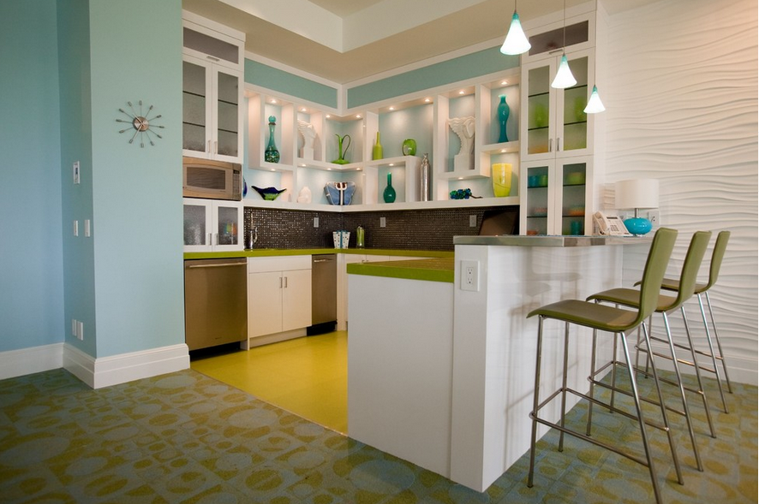
What type of line do you see?

Slide 11
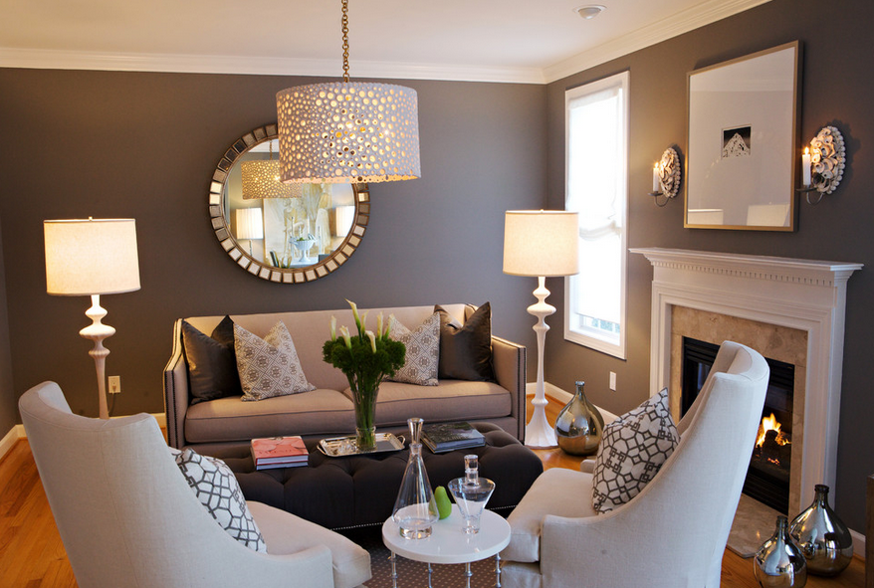
What type of line do you see?

Slide 12
What type
of line do
you see?

Slide 13
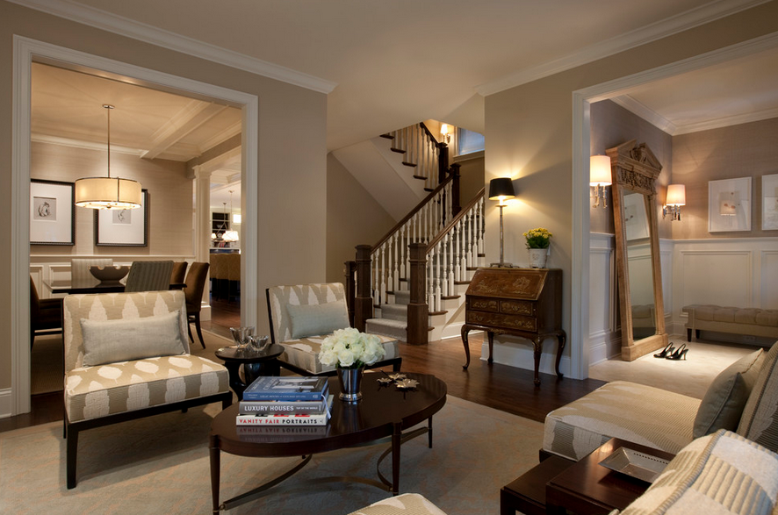
What type of line do you see?

Slide 14
Lines Can Create Illusions:
Here are a few:

Slide 15
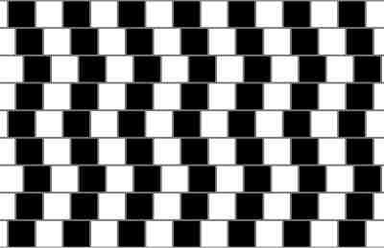
Are the horizontal lines straight or curved?

Slide 16
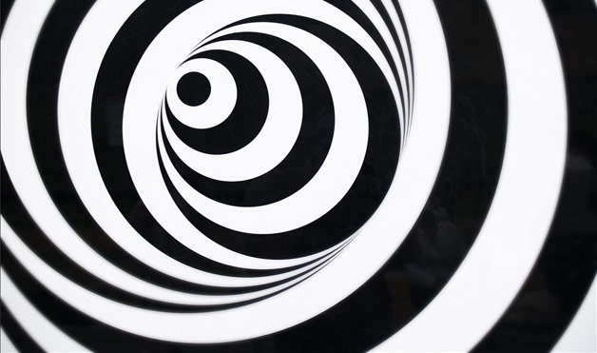

Slide 17
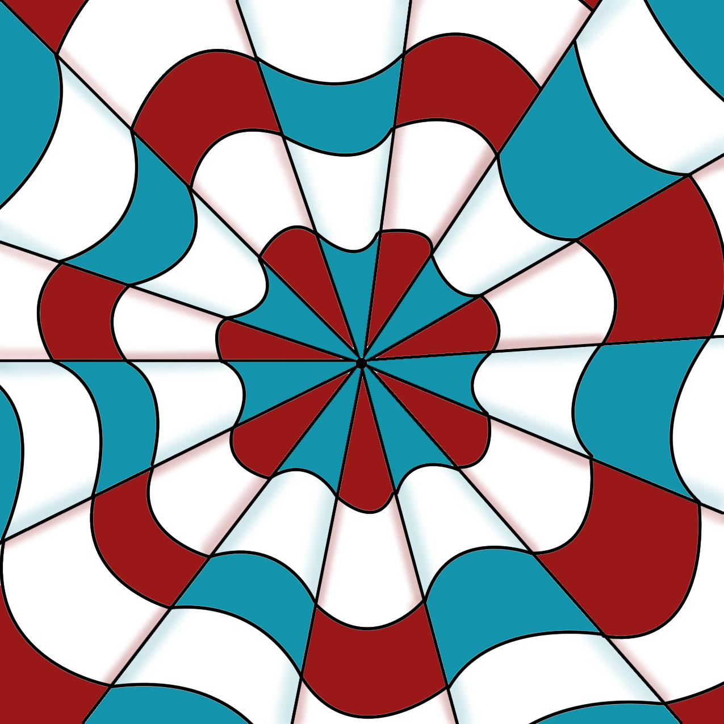

Slide 18
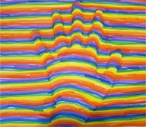
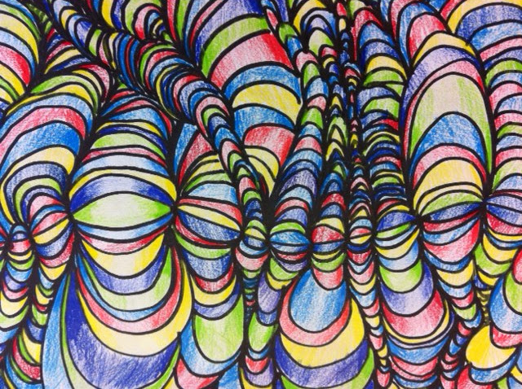
Create an Illusion of your own?
On a half sheet of white cardstock.
Create your own line illusion:
You must include at least three types of line.
The illusion must also include color.
This page will be included in your notebook.
Here are just some ideas. Be creative.

Slide 19
