Slide 1
Safety and Sanitation

Slide 2
When working with ELECTRIC APPLIANCES, the safety rules are:
Keep your hands dry.
2. Stand on a dry surface.
3. Keep electric appliances away from water.

Slide 3
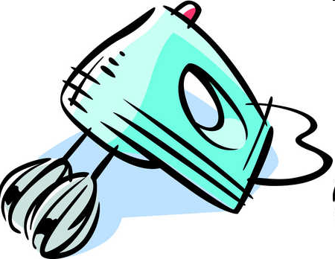
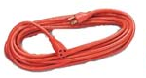
4. Avoid using metal objects on electrical appliances.
5. Unless absolutely necessary, avoid using an extension cord, make sure the appliance cord as well as any extra parts are in good condition.

Slide 4
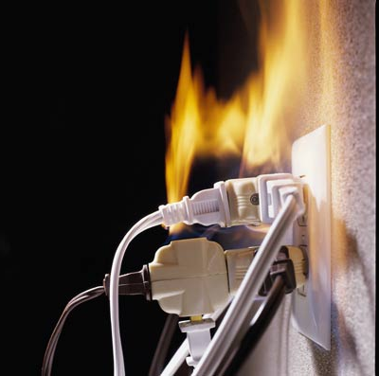
6. Do not PLUG too many appliances into the same outlet. It could get over-loaded and explode or get over-heated and cause a blackout.
7. When cleaning appliances, make sure that they are unplugged.

Slide 5
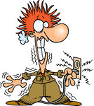
8. If someone is getting shocked by an appliance, first TURN OFF THE MAIN POWER SOURCE then unplug the appliance before approaching the injured person.

Slide 6
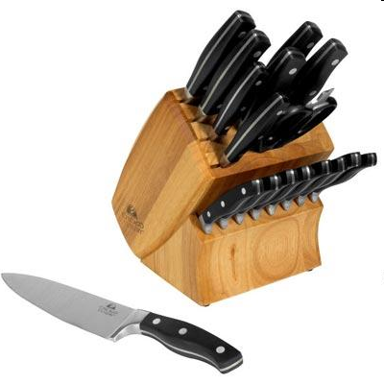
To avoid CUTS:
SHARP knives are safer than dull knives.
2. Do not put knives in a drawer full of knives.
3. Store knives in a knife block or a knife rack.

Slide 7
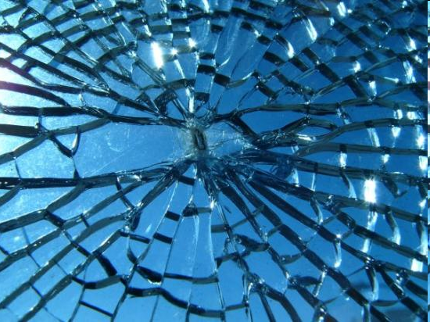
4. Clean up any broken glass immediately; and wrap your hand in a wet paper towel before touching the broken glass.
*If this happens in the lab, get me immediately and let me know what was broken and if anyone was hurt.

Slide 8
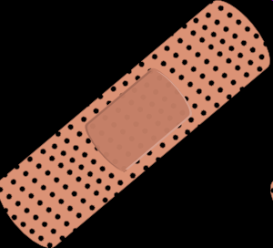
5. In the case of someone getting cut, the general rule is to APPLY PRESSURE by using a clean cloth covering the wound and pressing directly on the wound.
6. Sometimes, you will need to apply pressure on the wound and on the nearest PRESSURE POINT.

Slide 9
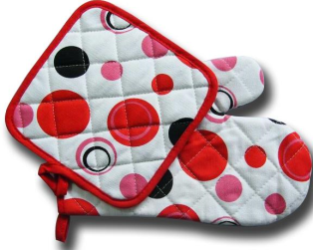
To avoid getting BURNED:
Stand to the side of the oven when opening it.
2. Use hot pads for handling hot pans etc. (this includes those coming out of the microwave).

Slide 10
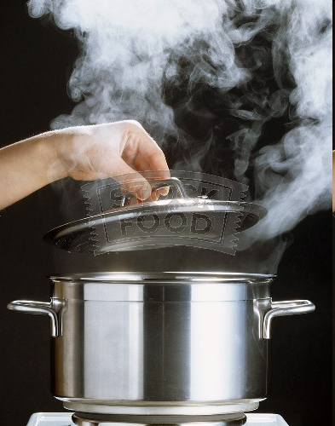
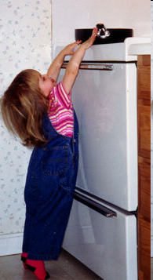
3. Lift the lids off of foods so the steam goes AWAY FROM YOU and your face.
4. Pull the rack of the oven out, rather than having to reach in.
5. Turn pan handles toward the INSIDE or BACK of the stove.

Slide 11
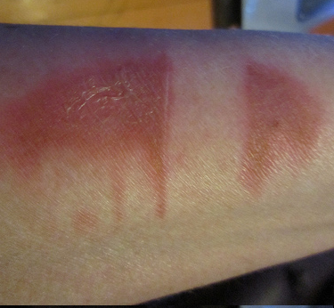
6. If it is a FIRST degree burn, it will be red, but there will not be any blisters. In this case, you should RUN IT UNDER COLD WATER.

Slide 12
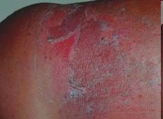
7. If it is a second degree burn, it will have blisters and be red. In this case, you can cover with a cool cloth, or have a doctor check it if it is a large area.

Slide 13
8. If it is a third degree burn, the skin will be discolored or melted away. In this instance, you should determine how large of an area is burnt, then call for help. Avoid touching the burnt area and lightly cover the area with a cool cloth.

Slide 14
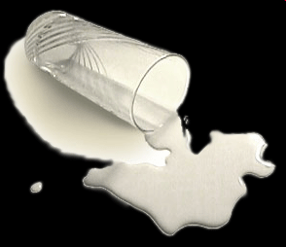
How to avoid FALLS:
Use a STEP-STOOL to reach things in high places.
2. Clean any SPILLS as soon as they happen.

Slide 15
3. If there is a fall, assess the injuries:
a. Make sure they are breathing.
b. Check for bleeding.
c. Make them comfortable.
d. Remove them from activity path.

Slide 16
To help prevent FIRES:
Keep all flammable objects away from direct heat.
2. Never put paper towels on the range.
3. Watch your stove carefully. Never leave it unattended.

Slide 17
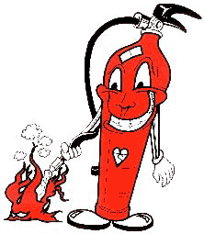
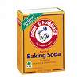
4. If it is a grease fire:
Put a LID on it
Pour BAKING SODA on it
Use a fire EXTINGUISHER

Slide 18
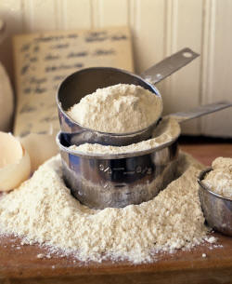
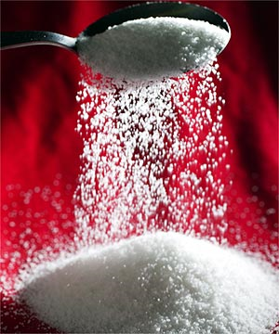
5. Do NOT ever use:
WATER
SUGAR
FLOUR

Slide 19
What would happen if you threw water on a grease fire?

Slide 20
Cleaning and Cleaning Supplies:
You should keep all surfaces and equipment clean.
2. Wash the counter with a disinfectant before you begin to cook.
3. CLEAN AS YOU GO. It will keep the area clean and will make the clean-up much easier.

Slide 21
4. To properly wash dishes:
a. Throw away or rinse any food left on dishes
b. Fill one sink with hot soapy water
c. Fill the other sink with plain hot water
d. Wash dishes in soapy water, then rinse all soap away in the plain hot water
e. Place dishes in dish rack or dry with a clean towel

Slide 22
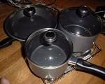
5. When you are doing the final clean-up, you should wash the dishes in the following order:
a. Glassware
b. Silverware/Flatware
c. Dishware
d. Kitchen Tools
e. Pots and Pans

Slide 23
To prevent POISIONING and CONTAMINATION by cleaning supplies:
Keep all chemicals away from the food. Store them in a different place than you store your food.

Slide 24
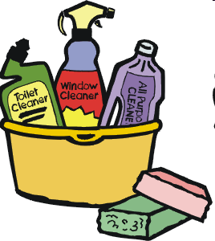
2. Keep supplies in their ORIGINAL CONTAINERS and make sure they are labeled with their contents, what they are there for, and how to use them.

Slide 25
3. The safest rule as far as mixing cleaning supplies is: DO NOT MIX THEM!
4. Combinations like AMMONIA and BLEACH will produce a deadly TOXIC GAS!

Slide 26
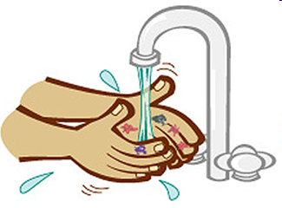
Sanitation Rules:
Always wash hands for a minimum of 20 seconds with hot soapy water.
Notes:
26

Slide 27
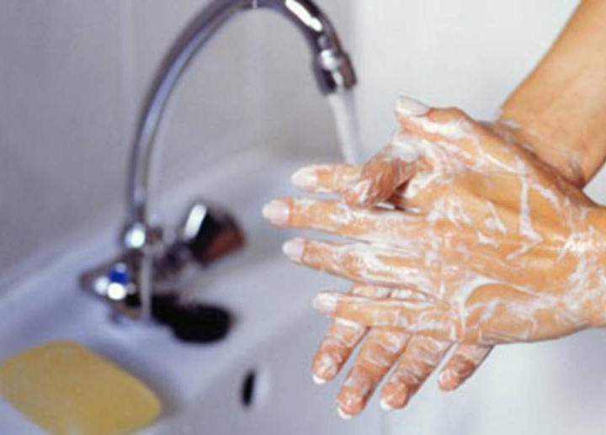
2. Wash your hands:
BEFORE Cooking
DURING Cooking
AFTER Cooking or Handling Raw Meat
Notes:
27

Slide 28
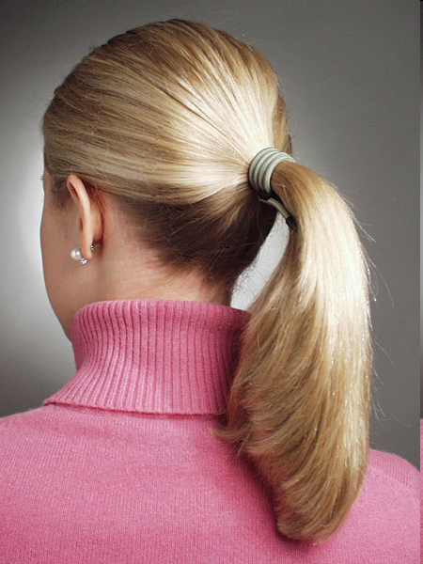
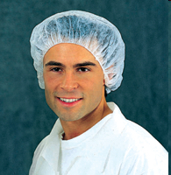
3. Wear gloves while cooking if you have a cut or open sore on your hands.
4. Pull back or cover hair while working in the kitchen.
Notes:
28

Slide 29
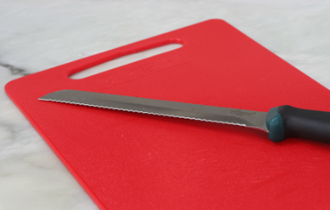
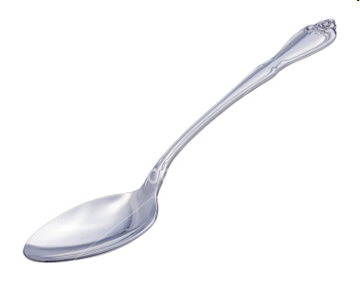
5. Use plastic cutting boards, not wooden ones.
6. When tasting foods, use a clean spoon every time.
Notes:
29

Slide 30
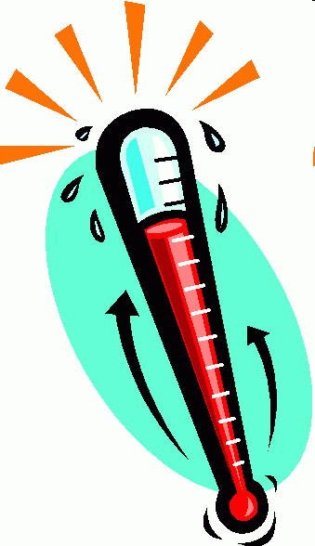
7. Keep foods out of the Temperature Danger Zone: 41° to 135°.
8. Foods should be stored within two hours.
Notes:
30

Slide 31
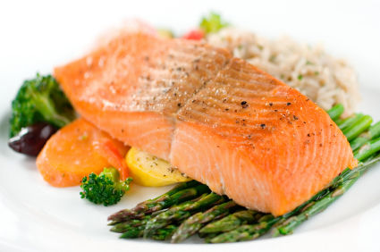
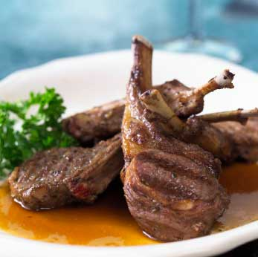
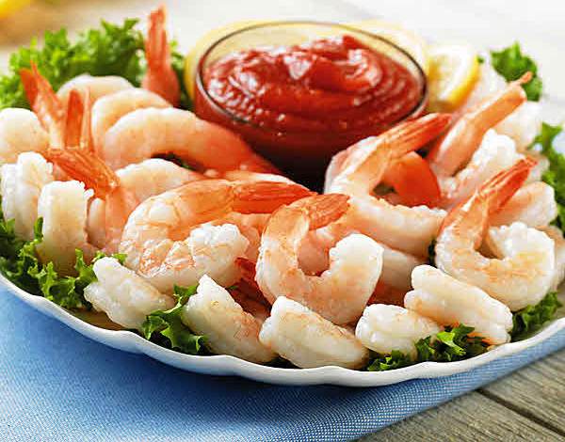
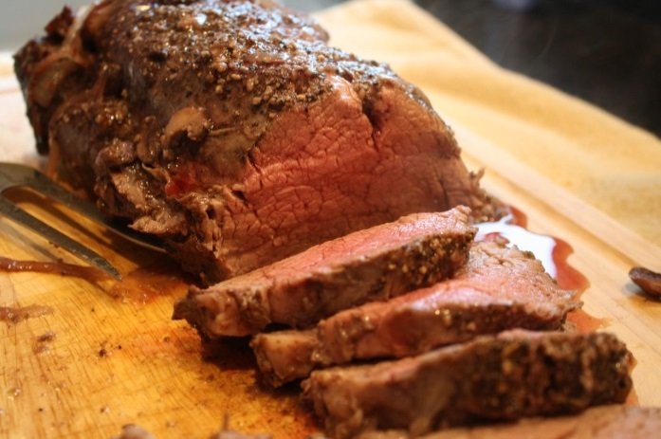
9. Always check the internal temperature of foods with a food thermometer.
10. Seafood, beef , veal, lamb and pork should be cooked to at least 145°.
Notes:
31

Slide 32
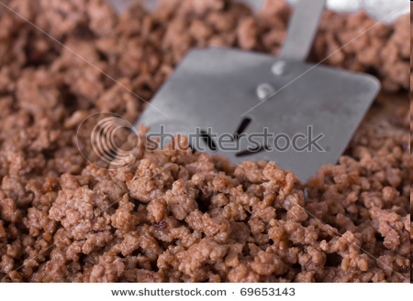
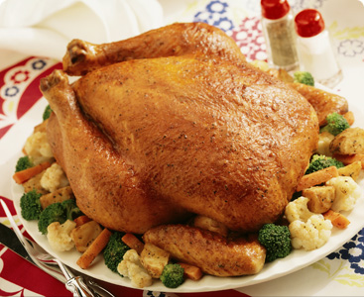
11. Ground meats, such as ground beef, should be cooked to at least 155°.
12. All poultry should be cooked to at least 165°.
Notes:
32

Slide 33
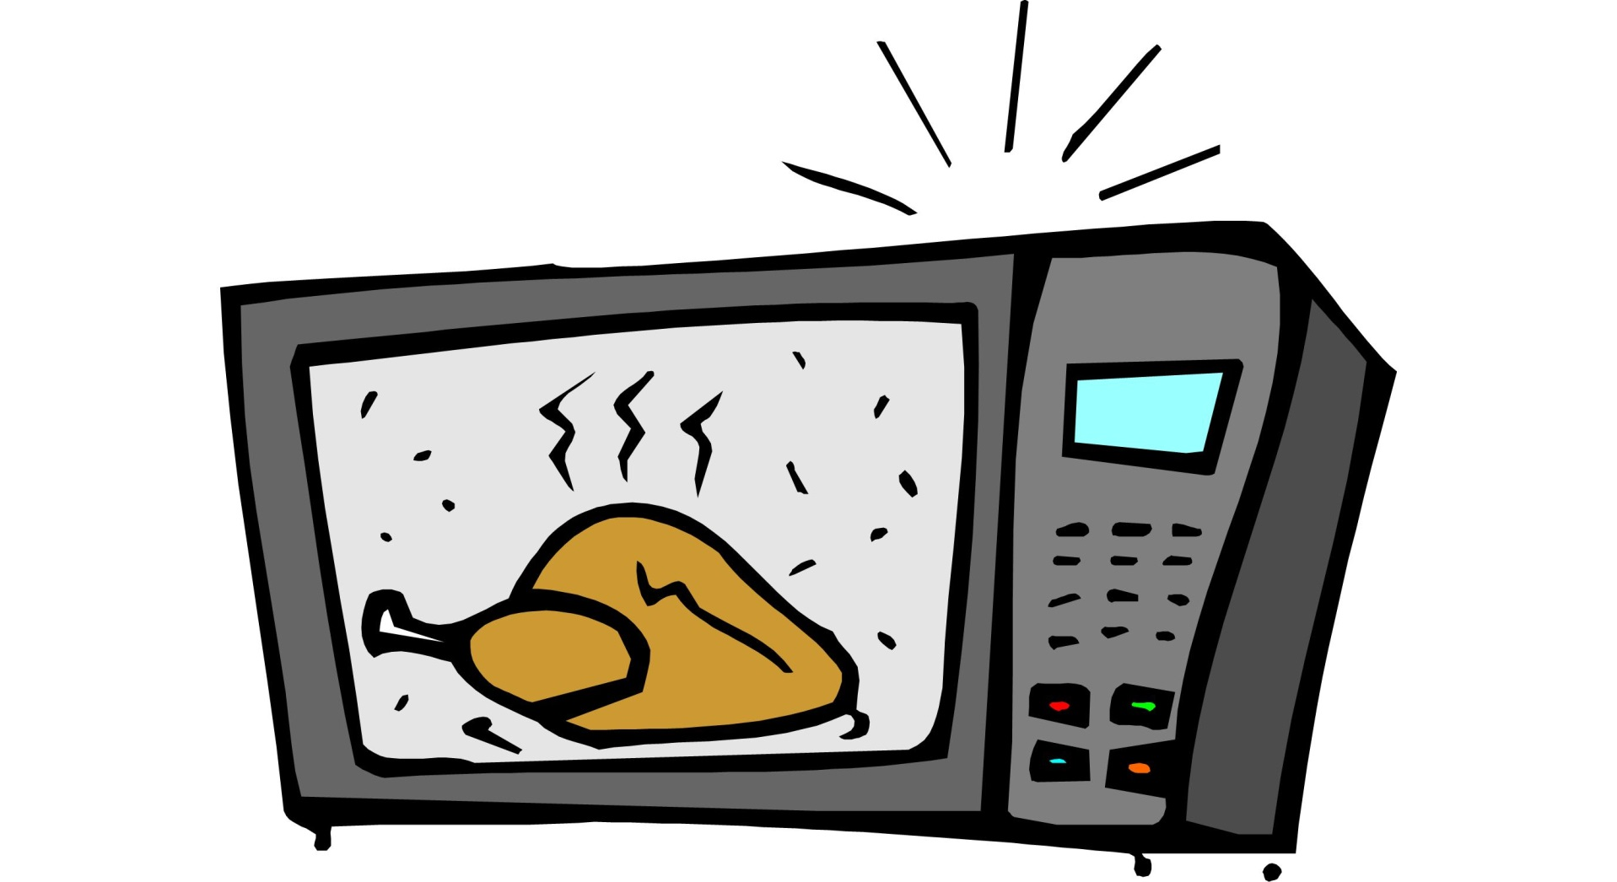
13. When reheating food, make sure the internal temperature is at least 165°.
Notes:
33

Slide 34
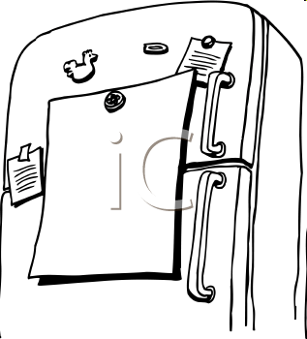
14. Keep hot foods HOT and cold foods COLD.
15. When in doubt, THROW IT OUT!
Notes:
34

Slide 35
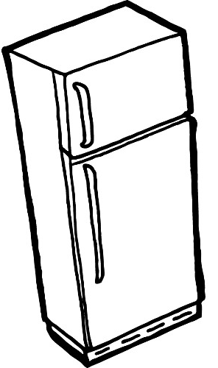
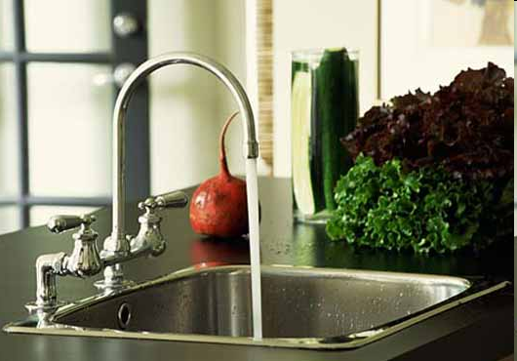
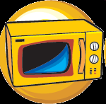
16. The best ways to THAW frozen food:
In the fridge for 2-3 days
b. Under cold, running water
c. In the microwave, if used immediately
Notes:
35

