Slide 1
Quick Breads
1. They are Quick or Fast (<1 Hr.)
2. They do not use yeast!
3. Baking powder /soda provide leavening
4. They do not need to rise
1. Dough
1. Biscuits
2. Scones
3. Doughnuts
2. Batter
1. Pour
Waffles, Pancakes
2. Drop
Muffins

Slide 2
Characteristics
Flour
Purpose: Gives Structure
Liquid
Purpose: Moistens & Dissolves Ingredients
Salt
Purpose: Gives Flavor

Slide 3
Baking Soda/Powder
Purpose: Leavening Agent (Helps it rise)
Fat
Purpose: Makes it Tender & Gives Flavor
Sugar
Purpose: Gives Flavor & Helps with Browning
Eggs
Purpose: Gives Protein, Color & Leavening

Slide 4
Gluten: when water is mixed with flour, the proteins in the flour give strength and elasticity to batters and dough's.
Kneading: to work a dough with the palms of the hands to develop gluten.

Slide 5
Muffin Method of Mixing
Combine all dry ingredients together into a bowl.
In a separate bowl, blend all of the liquid ingredients together, (including fat).
Make a well in your dry ingredient bowl and pour the liquid in the well.
Stir until dry ingredients are moistened.

Slide 6
The Perfect Muffin:
Cauliflower top
Few Tunnels Inside
Tender
DRAW THIS:

Slide 7
The Under-Mixed Muffin:
Low Volume
Flat Surface
Very Crumbly
DRAW THIS:

Slide 8
The Over-Mixed Muffin:
Peaked Top
Very Tough
Large Tunnels Inside
DRAW THIS:

Slide 9
Biscuit Method of Mixing:
Combine all dry ingredients.
Cut-in the fat until there are crumbs.
Add the liquid and stir until a dough forms.
Knead the dough so gluten will form.
Cut into biscuits with biscuit cutter.
Place on a greased cookie sheet.

Slide 10
What does a perfect biscuit look like?
Flat Top
Straight Sides
Flaky with Layers
DRAW THIS:

Slide 11
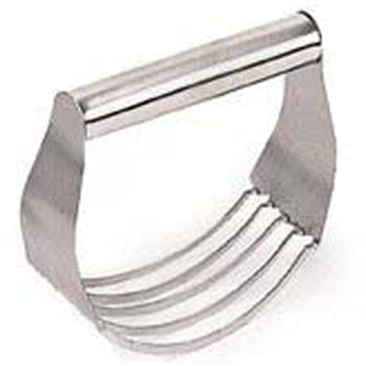
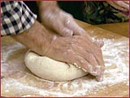
Two of the most important steps in making biscuits are:
Cutting-In the Fat (To Create the Layers)
Kneading (To Develop Gluten)

