Slide 1
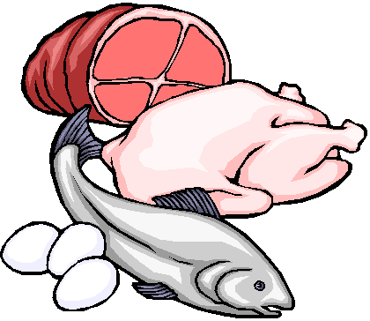
PROTEIN

Slide 2
Protein
Proteins provide 4 calories per gram.
The main function of protein is to build and repair body tissues.
If carbohydrates and fat are not available, your body will use protein. Is this a good thing?
You must eat protein daily to replace the wear and tear on the body tissues.
We get most of our protein from the Protein Food Group.
It is recommended that we choose 8 oz. of seafood products in the place of some meat and poultry every week.

Slide 3
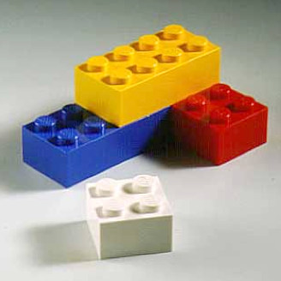
Amino Acids
6. Amino acids are the “building blocks” of protein.
7. There are 9 essential amino acids.
8. Essential means that your body MUST have them.

Slide 4
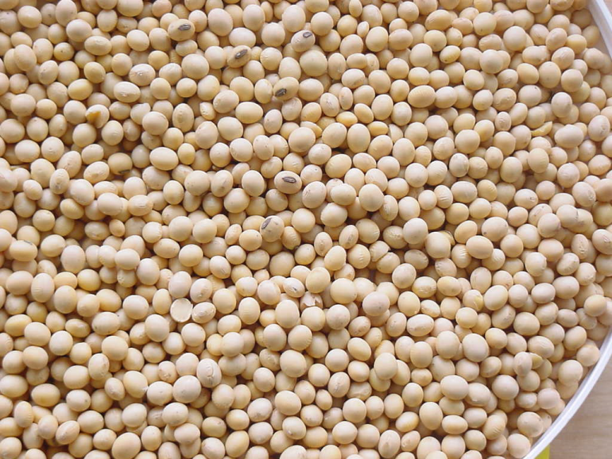
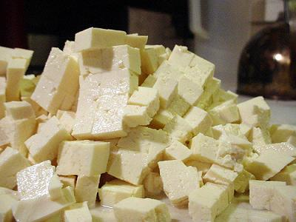
Complete Proteins
Complete proteins contain all 9 of the essential amino acids.
Complete proteins come from animal food sources.
Tofu (from soybeans) is the only complete protein from a plant source.

Slide 5
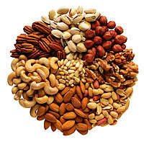
Incomplete Proteins
Incomplete proteins do NOT contain all of the essential amino acids.
Incomplete proteins come from plant food sources.
Examples of incomplete proteins could be:
Grains
Beans
Nuts/Seeds
Rice
Wheat

Slide 6
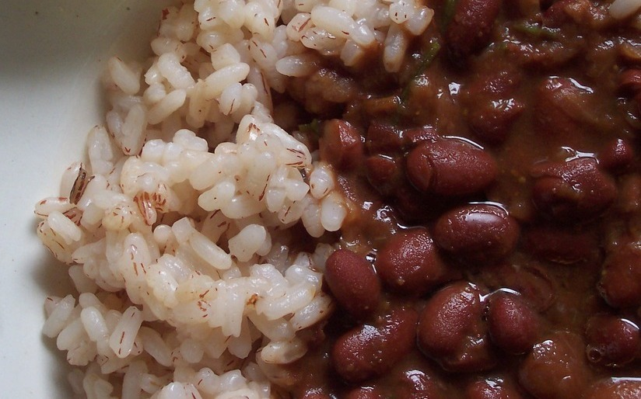
Combining Proteins
Incomplete proteins can be combined to create a complimentary protein.
Examples include:
Beans and Rice
Peanut Butter and Whole Wheat Toast
Bean Soup with a Wheat Roll

Slide 7
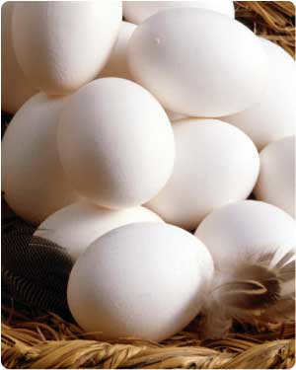
Eggs

Slide 8
Parts of the Egg
Air Pocket
Thick Albumin (Egg White)
Around the egg yolk
Thin Albumin (Egg White)
Between the thick albumin and the shell
Yolk
High in fat and cholesterol
Chalazae
Keeps the yolk centered
Shell
Protects the egg contents

Slide 9
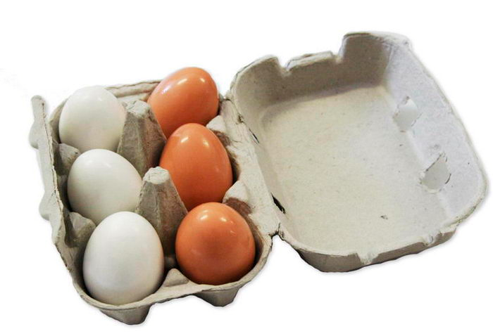
Storing Eggs
Eggs are very porous. They should be stored in their original carton. The cardboard helps block unwanted odors from seeping into the eggs.
Eggs have an expiration date printed on the carton. They usually last several weeks.

Slide 10
Cooking Eggs
Methods of cooking eggs include:
When eggs are cooked, they coagulate. This means that the liquid transforms into a solid.
Hard Cooked
Soft Cooked
Scrambled
Fried
Poached

Slide 11
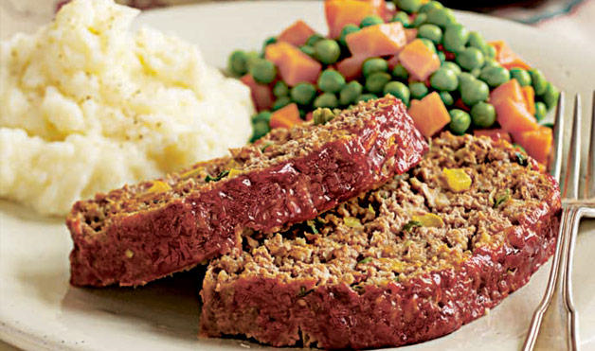
Functions of Eggs
5. Eggs perform different jobs in different foods. These include:
Binder Example: Meat Loaf

Slide 12
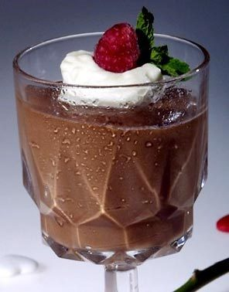
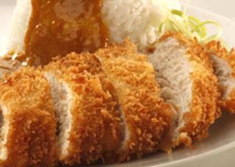
Thickener Example: Pudding
c. Coating Example: Breaded Chicken

Slide 13
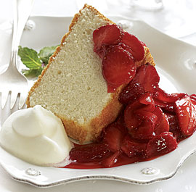
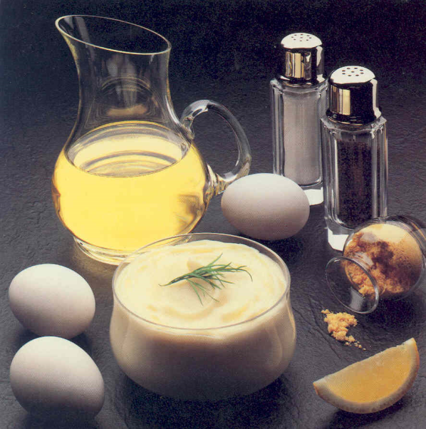
Leavening Agent Example: Angel Food Cake
e. Emulsifier Example: Mayonnaise
*Emulsifiers make two unmixable substances mix. (Oil and vinegar, grease and dish soap)

Slide 14
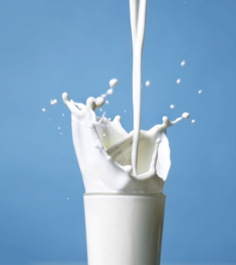
Milk

Slide 15
Milk
It is recommended that we switch to low-fat or fat-free milk and get least 3 cups daily from the Dairy food group.
Milk and milk products, (yogurt, cheese, etc.) are excellent sources of complete proteins because they come from animal sources.

Slide 16
Nutrients In Milk
By law, milk must be fortified with Vitamins A and D.
Fortified means that “extra” has been added to the product.
You can also get Vitamin D from sunlight. That is why it is sometimes called the “Sunshine Vitamin.”
Milk products also provide important minerals like Calcium, Iron and Phosphorus to help build healthy bones and teeth.

Slide 17
Processing Milk
7. Milk goes through several treatments before it is safe to drink. Two of these processes are:
Pasteurization: milk that has been heat treated to remove or kill harmful organisms.
Homogenization: the fat particles in milk have been broken down and evenly distributed so they cannot join together again.

Slide 18
Types of Milk
8. There are several types of Milk:
Type of Milk | Description
a. Whole Milk | Contains the highest amount of fat-(At least 3.25% or more)
b. 2% Milk | Contains only 2% milk-fat
c. 1% Milk | Contains only 1% milk-fat
d. Skim Milk (Fat-Free Milk) | Contains no fat
e. Non-Fat Dry Milk | Skim milk that has been dehydrated and packaged
f. Evaporated Milk | Milk that has had all water evaporated out of it

Slide 19
Types of Milk, cont.
Type of Milk | Description
g. Sweetened Condensed Milk | Milk with sugar added and then had water evaporated out
h. UHT Milk (Ultra High Temperature) | Milk heated to 280° for 2 seconds to kill bacteria
i. Lactose Free Milk | Milk that has had the lactose sugar removed
j. Buttermilk | Milk with lactic acid added
k. Acidophilus Milk | Special milk to help those with digestive disorders
l. Flavored Milk | Milk with flavorings added (chocolate, strawberry, etc.)

Slide 20
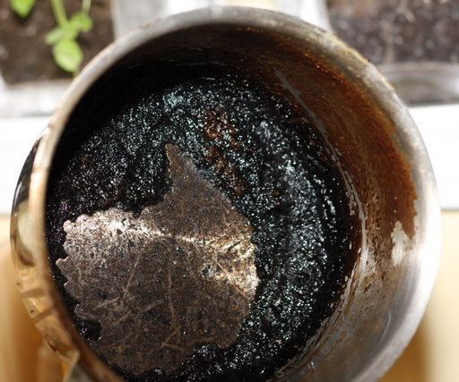
Cooking With Milk
Milk products scorch easily.
Scorching occurs when the proteins in milk are overcooked. They fall and cling to the bottom of the pan. They create a thick, black layer that is difficult to remove.

Slide 21
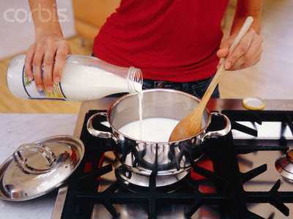
Cooking Milk, cont.
To prevent scorching, cook milk on low heat and stir it constantly to prevent the proteins from collecting on the bottom of the pan.
Heating milk in the microwave will also prevent scorching.

Slide 22
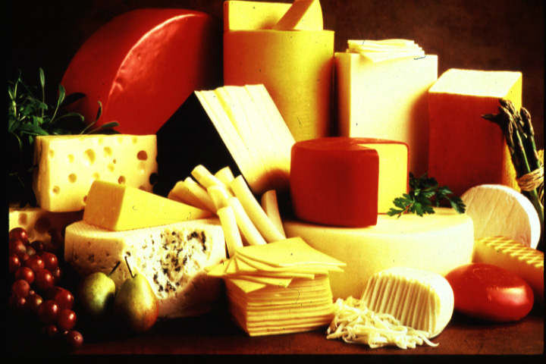
Cheese

Slide 23
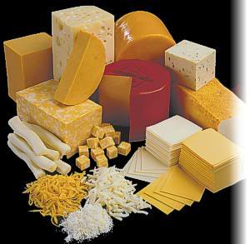
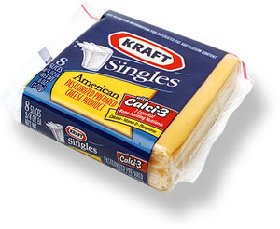
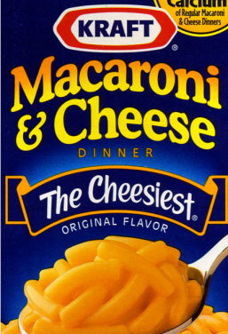
Types of Cheese
There are two types of cheese: Natural and Processed.
VS.

Slide 24
Natural Cheese
2. Natural cheeses include:
Type of Cheese | Examples
a. Fresh (Unripened) | Cream Cheese, Feta, Mozzarella, Ricotta
b. Soft Cheeses | Brie, Boursin, Camembert
c. Semi-Soft Cheeses | Fontina, Gorgonzola, Gouda
d. Firm Cheeses | Cheddar, Gruyere, Provolone
e. Hard Cheeses | Asiago, Parmesan

Slide 25
Processed Cheese
3. Processed cheese is cheese made from natural cheeses, but has had emulsifiers, colorings and preservatives added to increase shelf-life. It is also easier and cheaper to produce.
4. Processed cheeses include:
Type of Cheese | Examples
a. Processed Cheese | American Cheese (Cheese Singles), Easy Cheese (Spray Cheese), Velveeta, Powdered Cheese

Slide 26
Reducing Fat Intake
5. To reduce fat intake in the Dairy group, you can:
Use a lower fat content milk
Use a lower fat content cheese
Substitute yogurt for mayonnaise

