Slide 1
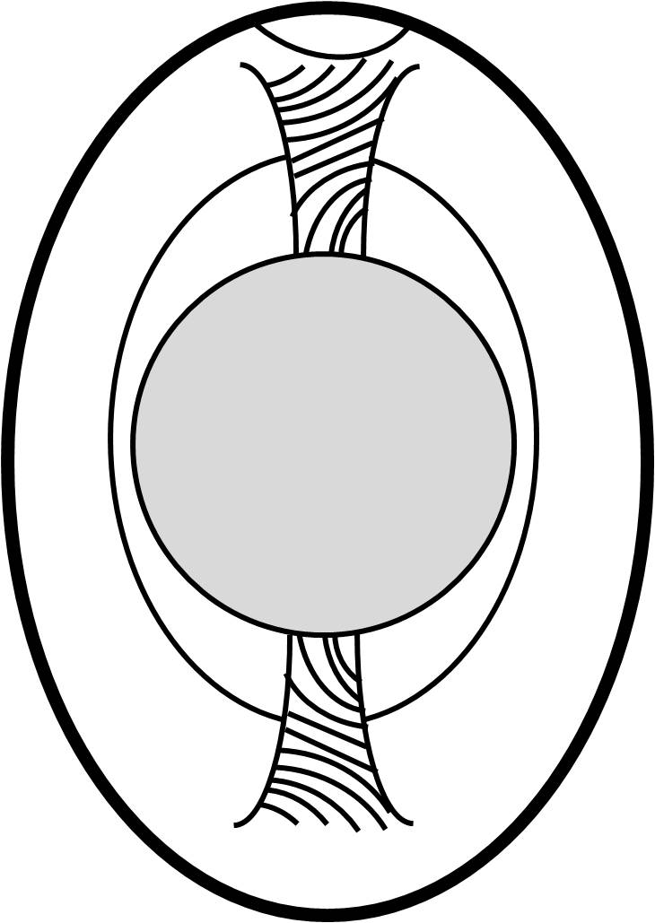
Parts of the Egg
Air Pocket
Thick Albumin (Egg White)
Around the egg yolk
Thin Albumin (Egg White)
Between the thick albumin and the shell
Yolk
High in fat and cholesterol
Chalazae
Keeps the yolk centered
Shell
Protects the egg contents

