Slide 1
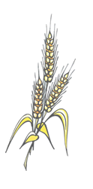
Carbohydrates

Slide 2
Carbohydrates
We get most of our carbohydrates from the GRAINS group.
FRUITS and VEGETABLES are also a good source of carbohydrates.
Almost all of our carbohydrates come from PLANT food sources.
The main function of carbohydrates is to PROVIDE ENERGY. They provide FOUR calories per gram.

Slide 3
If we eat more carbs than our bodies need for energy, they get stored as FAT.
The three types of carbohydrates are:
SIMPLE SUGARS
COMPLEX STARCHES
FIBER
Sugars are SIMPLE. Starches are COMPLEX.
Complex starches will BREAK DOWN into simple sugars.

Slide 4
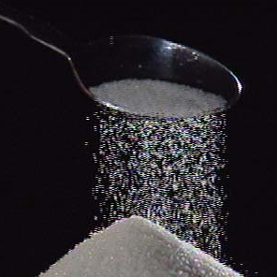
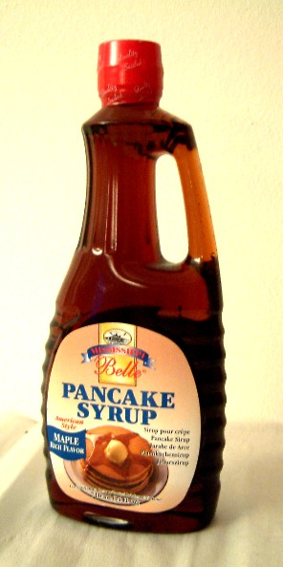
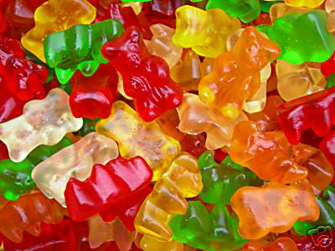
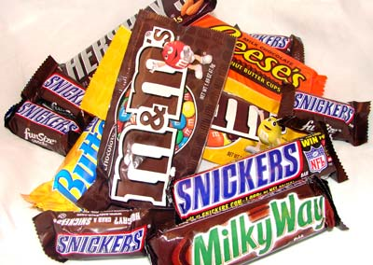
SIMPLE SUGARS
Food Sources:

Slide 5
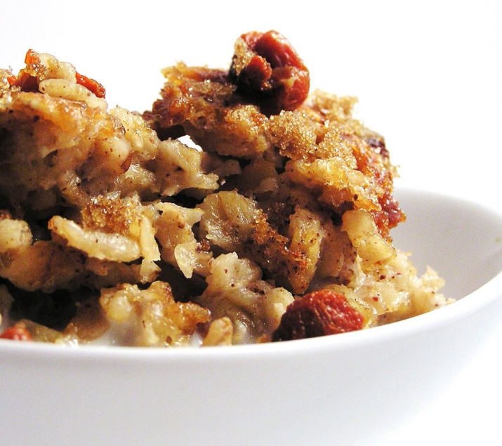
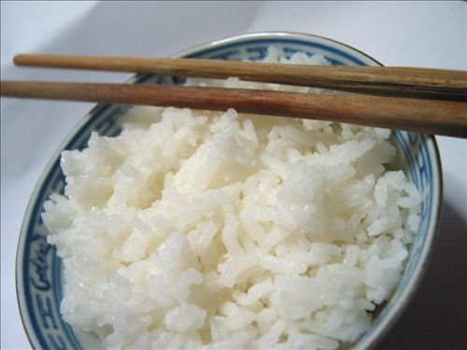
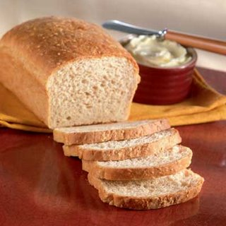
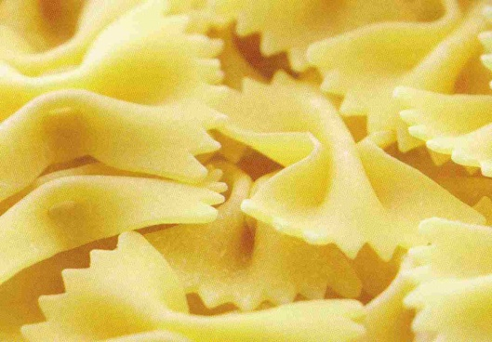
COMPLEX STARCHES
Food Sources:

Slide 6
List the different types of sugars and their food sources:
SUGAR | OTHER NAME | FOOD SOURCES
Glucose
Fruit, Veggies, Grains
“Blood Sugar”
Sucrose
Table Sugar, Sugar Cane
“Table Sugar”
Fructose
“Fruit Sugar”
Fruit
Maltose
“Malt Sugar”
Grains
Lactose
“Milk Sugar”
Milk

Slide 7
Fiber
The average American does not get enough FIBER in their diets.
The National Cancer Institute recommends that the average person gets 20-35 GRAMS of fiber every day.
Two other common names for fiber are: ROUGHAGE or CELLULOSE.

Slide 8
Fiber is important because it attracts WATER to the INTESTINES and helps move food through our systems faster. You have to have water along with fiber or it is not as effective.
5. Benefits of fiber include a lowered risk of DIVERTICULITUS, hemorrhoids and colon or rectal cancer.

Slide 9
6. List the two types of fiber and the main functions they perform:
Type of Fiber | Function
Shown to lower total blood cholesterol
A. Soluble
Insoluble
*Will NOT digest or dissolve
Helps move food through the body
7. Cellulose is insoluble, or non-digestible.

Slide 10
8. Fiber only comes from PLANT food sources. You CANNOT get fiber from animal food sources.
9. Foods that are high in fiber include:
Fruits and Veggies (Especially the Skins!)
Whole Grains
Legumes/Beans
Bran
10. Ways to increase fiber in the diet include:
Make Half Your Grains Whole grains
Use Whole Wheat Flour
Eat the Skins

Slide 11
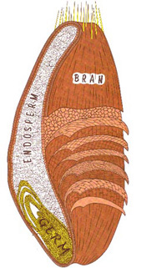
11. Label the Wheat Kernel below:
__ENDOSPERM___
Provides:
Starch
Protein
__Bran___
Provides:
Fiber
Vitamins
Minerals
__GERM___
Provides:
Unsaturated Fatty Acids
“B” Vitamins
Vitamin E
Iron
Zinc
Other Trace Minerals

Slide 12
12. The MOST beneficial part of the wheat kernel is the: Germ
13. The LEAST beneficial part of the wheat kernel is the: Endosperm

Slide 13
14. When a product claims that it is “Whole Wheat” or “Whole Grain”, it must use the ENTIRE wheat kernel, or ALL THREE parts.
15. Other products, like white bread and rice, usually only use the ENDOSPERM, which is the LEAST beneficial part of the wheat kernel.
16. ENRICHED: some of the nutrients that were lost in processing are added back into the product.
17. FORTIFIED: 10% more of the Daily Value for the nutrient is being added.

Slide 14
Yeast Breads
What is the purpose of each ingredient in yeast breads?
Flour: Body / Structure
Yeast: Provides leavening to make light, airy and porous
Salt: Flavor and controls yeast
Fat: Tenderness

Slide 15
e. Liquid: To dissolve and activate yeast
f. Sugar: Food for yeast
g. Egg: Color, texture and nutrients
What is proofing?
The period of time when the bread is rising and CO2 is being produced.
What happens if the liquid you add to the yeast is too hot?
It will kill it!

Slide 16
4. What happens if the liquid you add to the yeast is too cold?
It won’t react
What affect does salt have on yeast?
It controls yeast growth
What is the effect of mixing baking soda with an acid?
CO2 is produced

Slide 17
7. What are some common acids added to foods to help produce leavening? (List at least 3)
Sour Cream
Sour Milk (Buttermilk)
Vinegar
Cream of Tartar
Honey
Molasses
Lemon Juice

Slide 18
Quick Breads
1. They are Quick or Fast (<1 Hr.)
2. They do not use yeast!
3. Baking powder /soda provide leavening
4. They do not need to rise
1. Dough
1. Biscuits
2. Scones
3. Doughnuts
2. Batter
1. Pour
Waffles, Pancakes
2. Drop
Muffins

Slide 19
Characteristics
Flour
Purpose: Gives Structure
Liquid
Purpose: Moistens & Dissolves Ingredients
Salt
Purpose: Gives Flavor

Slide 20
Baking Soda/Powder
Purpose: Leavening Agent (Helps it rise)
Fat
Purpose: Makes it Tender & Gives Flavor
Sugar
Purpose: Gives Flavor & Helps with Browning
Eggs
Purpose: Gives Protein, Color & Leavening

Slide 21
Gluten: when water is mixed with flour, the proteins in the flour give strength and elasticity to batters and dough's.
Kneading: to work a dough with the palms of the hands to develop gluten.

Slide 22
Rice and Pasta
1. List the types of rice below:
Type of Rice | Description
Shorter than long grain rice. When cooked, it is moist and tender.
A. Conventional Rice
4-5 times longer than the width. After cooked, it will be light and fluffy.
B. Long Grain Rice
Short, plump and almost round. Cooked grains are soft and cling together.
C. Short Grain Rice
Chewy texture and “nut-like” flavor. Rich in vitamins, minerals and fiber.
D. Brown Rice *Has the most fiber!
Long, dark and streaky color. Distinct flavor.
E. Wild Rice
It has been completely cooked and then dehydrated. The process reduces time required for cooking.
F. Pre-Cooked/Instant Rice

Slide 23
2. To cook rice:
Use about 2 CUPS of water for every cup of rice.
Bring WATER to a boil.
Add rice and COVER the pan.
Bring water back up to a BOIL.
Reduce heat so rice will SIMMER.
Check for DONENESS. The rice should be TENDER but firm, and there should be no water left.
If some water remains, continue cooking, but remove the LID.
3. Rice Yield: 1 cup uncooked rice will make 3 cups cooked rice (1:3 ratio)

Slide 24
3. To cook pasta:
Use about 1 QUART of water for every 4 ounces of dry pasta.
Bring water to a BOIL.
Add pasta SLOWLY to boiling water so boiling does not stop.
DO NOT COVER the pan.
Stir pasta FREQUENTLY while it’s cooking.
Cook pasta to al dente stage (pasta remains firm to the bite).
Drain pasta in a COLANDER.
To keep pasta WARM, set the colander over a pan of hot water and cover with the colander.
3. Pasta Yield: 1 cup uncooked pasta will make 2 cups cooked pasta (1:2 ratio)

Slide 25
Muffin Method of Mixing
Combine all dry ingredients together into a bowl.
In a separate bowl, blend all of the liquid ingredients together, (including fat).
Make a well in your dry ingredient bowl and pour the liquid in the well.
Stir until dry ingredients are moistened.

Slide 26
The Perfect Muffin:
Cauliflower top
Few Tunnels Inside
Tender
DRAW THIS:

Slide 27
The Under-Mixed Muffin:
Low Volume
Flat Surface
Very Crumbly
DRAW THIS:

Slide 28
The Over-Mixed Muffin:
Peaked Top
Very Tough
Large Tunnels Inside
DRAW THIS:

Slide 29
Biscuit Method of Mixing:
Combine all dry ingredients.
Cut-in the fat until there are crumbs.
Add the liquid and stir until a dough forms.
Knead the dough so gluten will form.
Cut into biscuits with biscuit cutter.
Place on a greased cookie sheet.

Slide 30
What does a perfect biscuit look like?
Flat Top
Straight Sides
Flaky with Layers
DRAW THIS:

Slide 31
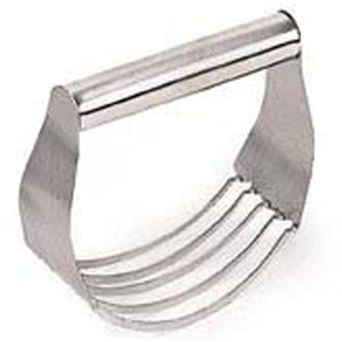
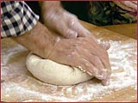
Two of the most important steps in making biscuits are:
Cutting-In the Fat (To Create the Layers)
Kneading (To Develop Gluten)

