Slide 1
Fashion Capitals
Paris, Tokyo, Milan, New York, London

Slide 2
Paris
Sophisticated, accessories are understated and smart.
First fashion capital
Yves Saint Laurent
Christian Dior
Chanel

Slide 3
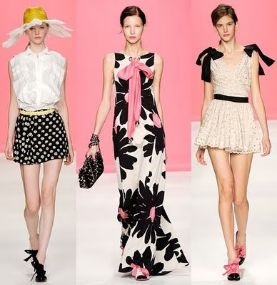
Milan
Casual elegance and luxury fibers.
Bright colors & bold ideas
Giorgio Armani- known for his subtle mannish styles for both men and women.

Slide 4
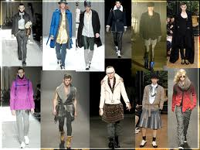
Tokyo
“Look” is loose and apparently unstructured.
Complicated cutting techniques.
Colors are often subtle, and somber.
Fabrics are rich in texture.

Slide 5
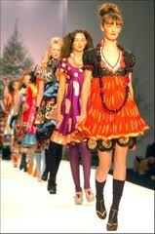
London
Unorthodox clothes, with a young market and popular appeal- punk
Vivienne Westwood

Slide 6
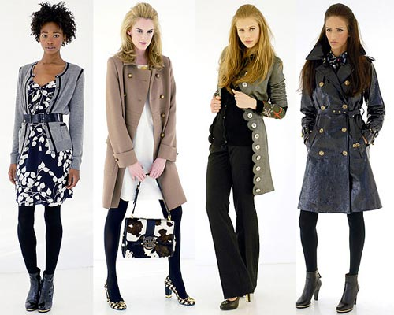
New York
Clean-cut and casual style reflecting athletic, health conscious life styles.
Natural fabrics
Calvin Klein
Ralph Lauren
Donna Karan

