Slide 1
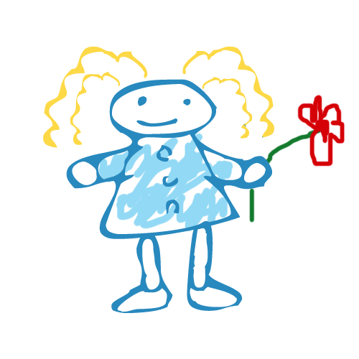
Imagination, Reading & Music

Slide 2
Why Are They Important?
Fosters Creativity
Promotes Problem-Solving Skills
Helps Children Become Critical Thinkers
Helps Children Practice and Apply Life-Skills
Helps Promote New Vocabulary and Retention (Story Telling)
Music Increases Information Retention (Memory!)

Slide 3
The Hokey Pokey
Verse 1:
You put your RIGHT HAND in,
You put your RIGHT HAND out,
You put your RIGHT HAND in and you shake it all about,
You do the hokey pokey and you turn yourself around,
That’s what it’s all about!
Verse 2: LEFT HAND Verse 7: RIGHT HIP
Verse 3: RIGHT FOOT Verse 8: LEFT HIP
Verse 4: LEFT FOOT Verse 9: HEAD
Verse 5: RIGHT SHOULDER Verse 10: WHOLE SELF
Verse 6: LEFT SHOULDER

Slide 4
Baby Bumblebee
I’m bringing home a baby bumblebee,
Won’t my mommy be so proud of me?
I’m bringing home a baby bumblebee,
OUCH! It stung me!

Slide 5
Once An Austrian Went Yodeling
Verse 1:
Once an Austrian went yodeling on a mountain so high
When he met with an AVALANCHE, interrupting his cry.
CHORUS:
Ho-le-ah…
1. Ho-le-rah-hi-hi-ah 5. Ho-le-rah-hi-hi-ah
2. Ho-le-rah Cuck-oo (RUMBLE, RUMBLE) 6. Ho-le-rah Cuck-oo (RUMBLE, RUMBLE)
3. Ho-le-rah-hi-hi-ah 7. Ho-le-rah-hi-hi-ah-oh.
4. Ho-le-rah Cuck-oo (RUMBLE, RUMBLE)
REPEAT CHORUS:
Verse 2: Skier (SWOOSH, RUMBLE, RUMBLE)
Verse 3: St. Bernard (ARF, ARF, SWOOSH, RUMBLE, RUMBLE)
Verse 4: Grizzly Bear (GRR, ARF, ARF, SWOOSH, RUMBLE, RUMBLE)
Verse 5: Milking Maid (TSS, TSS, GRR, ARF, ARF, SWOOSH, RUMBLE, RUMBLE
Verse 6: Pretty Girl (SMACK, SMACK, TSS, TSS, GRR, ARF, ARF, SWOOSH, RUMBLE, RUMBLE)

Slide 6
The Ants Go Marching
Verse 1:
The ants go marching 1 by 1, Hurrah, Hurrah!
The ants go marching 1 by 1, Hurrah, Hurrah!
The ants go marching 1 by 1,
The little one stops to suck his thumb,
And they all go marching down, to the ground,
To get out, of the rain,
Boom! Boom! Boom!
Verse 2: 2 by 2-tie his shoe Verse 7: 7 by 7-pray to heaven
Verse 3: 3 by 3-climb a tree Verse 8: 8 by 8-shut the gate
Verse 4: 4 by 4-shut the door Verse 9: 9 by 9-check the time
Verse 5: 5 by 5-take a dive Verse 10: 10 by 10-say “THE END!”
Verse 6: 6 by 6-pick up sticks

