Slide 1
Space
1. Space: The area the designer has to work with.
The Two Types of Space Are:
Positive Space | Negative Space
Area Being Used | Area NOT Being Used
Which type of Space is more important?.....

Slide 2
They are Equally Important!
You Can’t Have One Without The Other
(Like the Ying & Yang)

Slide 3
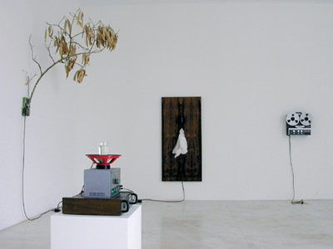
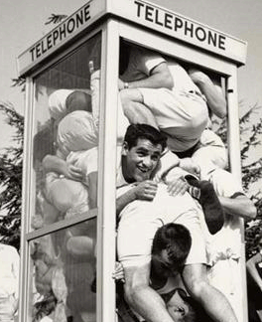
Problems That Can Occur With Space Are:
Too Much Space
Not Enough Space

Slide 4
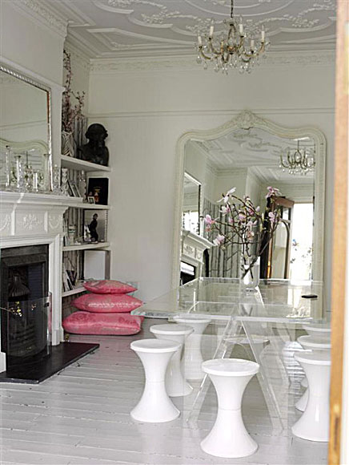
To Make An Area Seem MORE SPACIOUS:
Use small furniture, patterns and textures
Use a minimum of furnishings and accessories
Use light, cool colors
Use mirrors to create a feeling of depth
Place large furniture pieces near walls so they don’t break the room into smaller pieces
Allow as much floor as possible to show- (use furniture that has glass or tall legs)

Slide 5
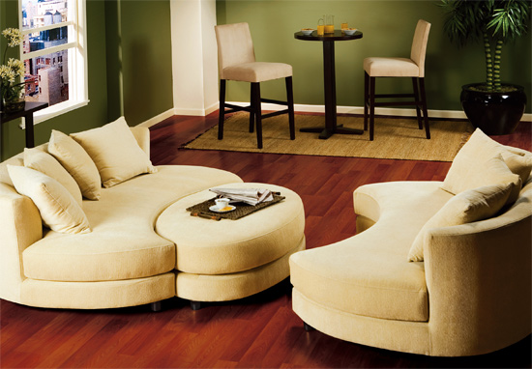
To Make An Area Seem LESS SPACIOUS:
Use contrasting patterns, colors and textures
Group furnishings together
Use warm, dark colors
Use soft, rough textures to absorb sound
Use furnishings of different heights to break a long, unobstructed view
Use large furniture that sits directly on or close to the floor
* If space is not correctly planned, then the other elements of the design will not be as effective!

Slide 6
Examples of
SPACE
Within Interiors

Slide 7
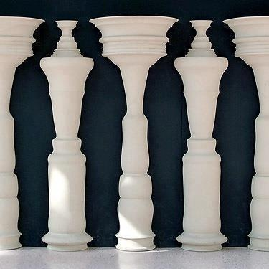

Slide 8
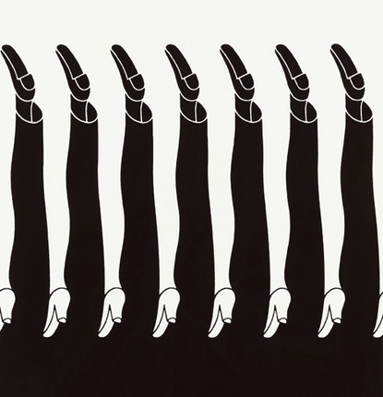

Slide 11
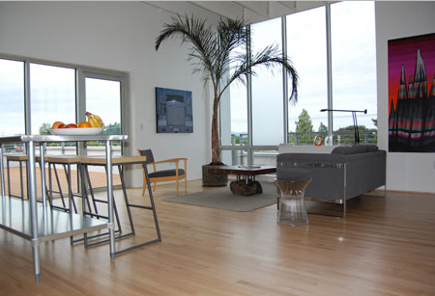

Slide 12
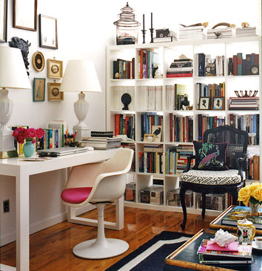

Slide 13
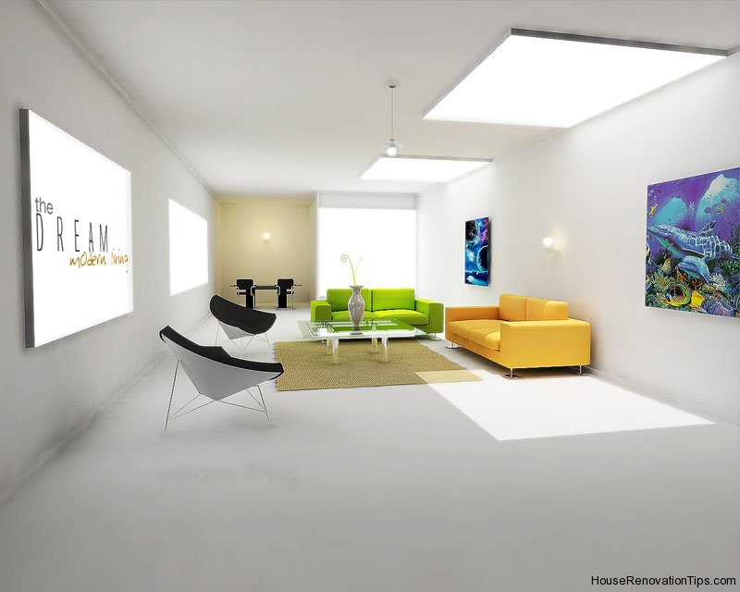

Slide 14
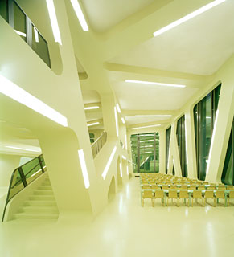

Slide 15
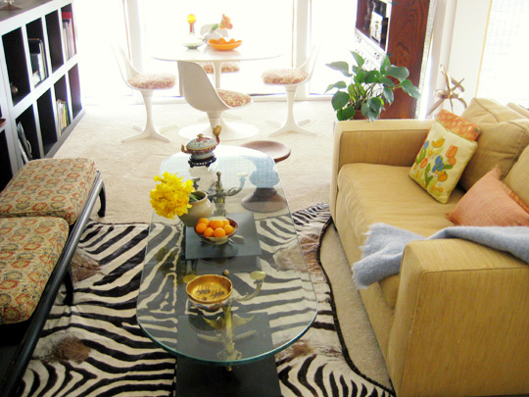

Slide 16
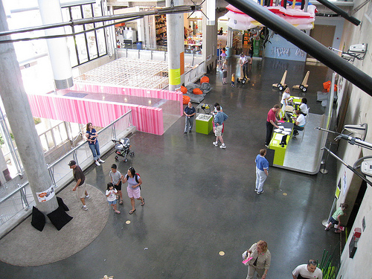

Slide 17
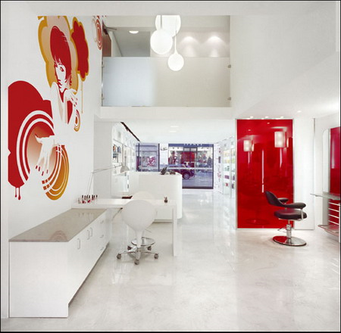

Slide 18
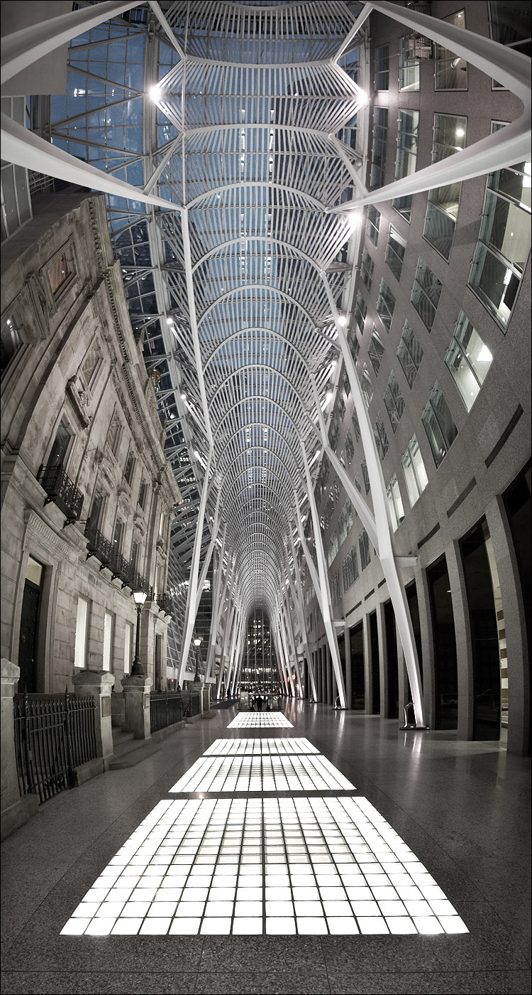

Slide 19
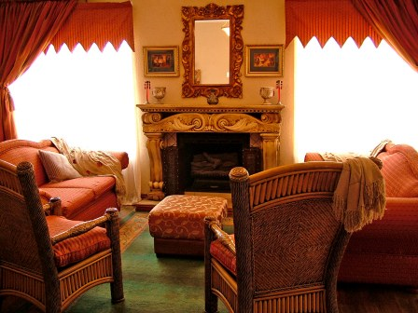

Slide 20
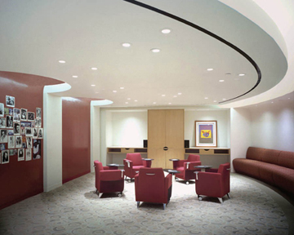

Slide 21
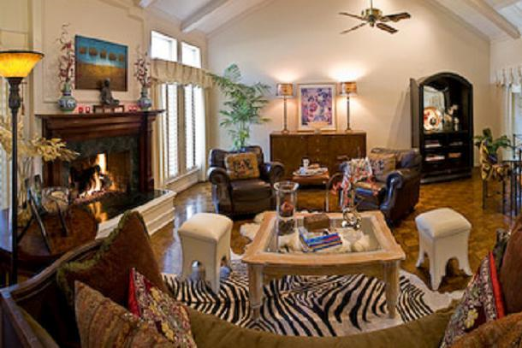

Slide 22
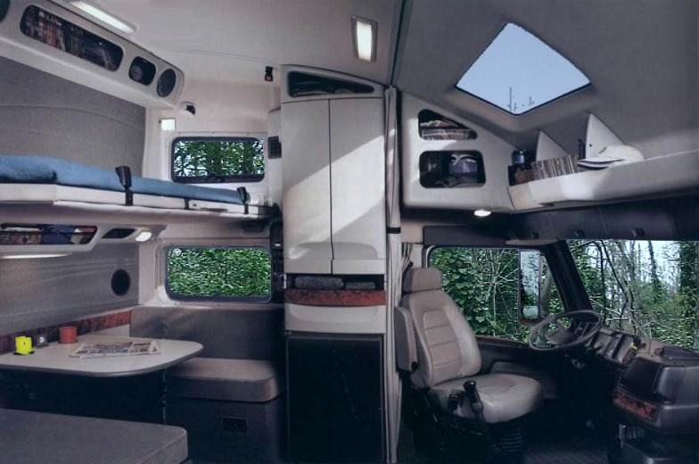

Slide 23
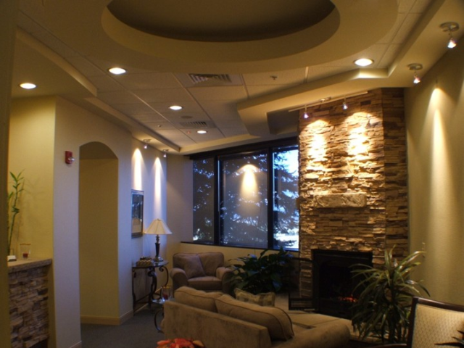

Slide 24
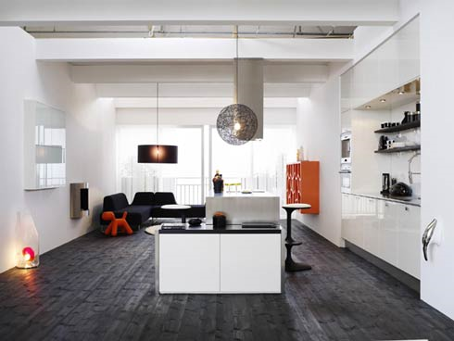

Slide 25
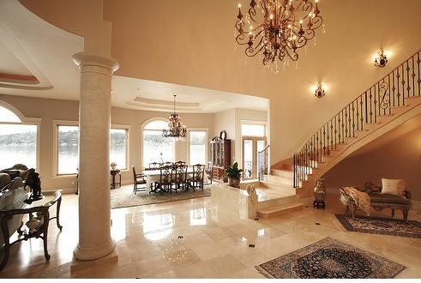

Slide 26
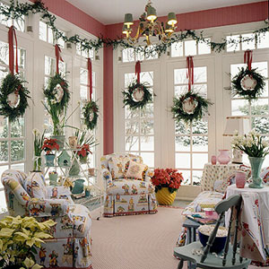

Slide 27
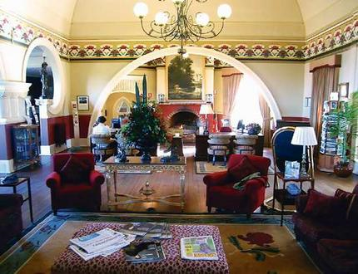

Slide 28
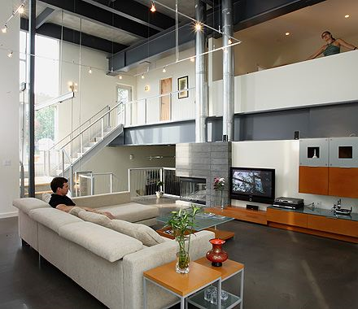

Slide 29
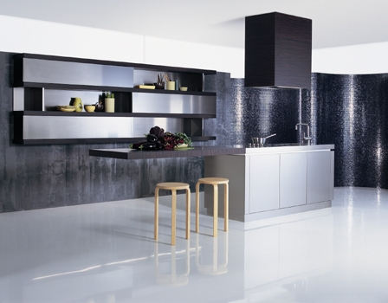

Slide 30
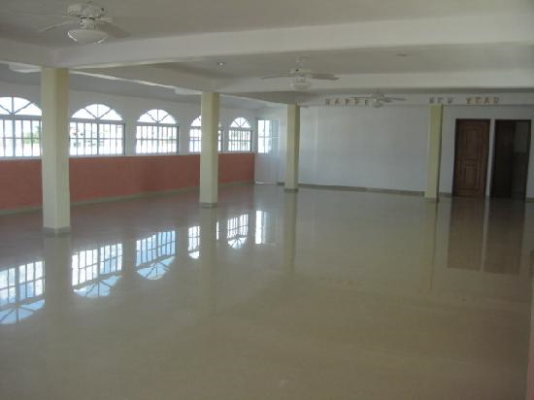

Slide 31
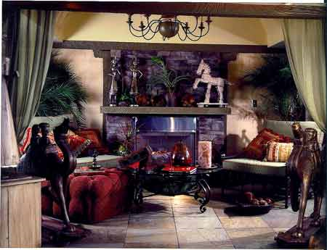

Slide 32
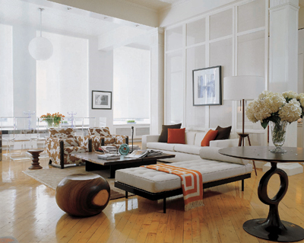

Slide 33
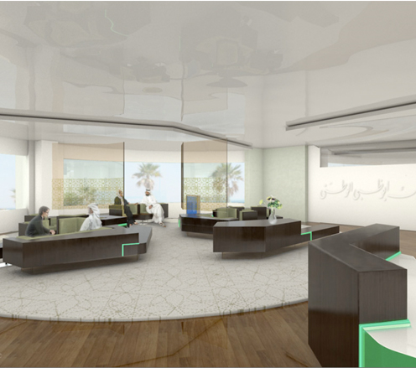

Slide 34
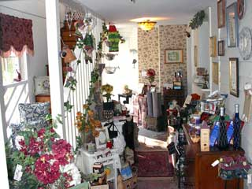

Slide 35
