Slide 1
One of the most expressive qualities of a line is direction. It has a profound effect on our emotions and perceptions.

Slide 2
There are FIVE Types of Lines…

Slide 3
1. Vertical
They Lift Space
Leads the Eye Up and Down
Adds Height and Slimness
Stability
Dignity
Formality

Slide 4
2. Horizontal
They Expand Space
Leads the Eye Left to Right
Adds Length and Width
Restful
Relaxing
Informal

Slide 5
3. Diagonal
They Extend Space
Activity
Movement
Energy

Slide 6
4. Curved
Upward Curves (Uplifting/Inspiring)
Downward Curves (Sadness/Uneasiness)
Horizontal Curves (Gentle/Relaxed)
Small Curves (Playfulness/Humor)
Softness
Gracefulness
Youthfulness

Slide 7
5. Zigzag
Electricity
Jumpiness
Confusion
Overpowering If Overused

Slide 8
Lines can EMPHASIZE or DE-EMPHASIZE shapes. They can also change the apparent PROPORTIONS of objects and rooms.

Slide 9
Examples of
LINE
Within Interiors

Slide 13
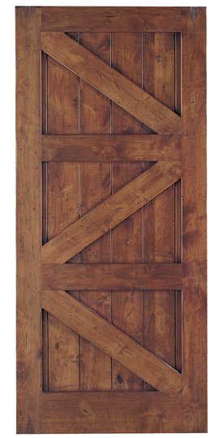
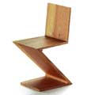
Tile Mosaic
Door
Chair

Slide 14
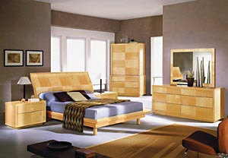

Slide 15
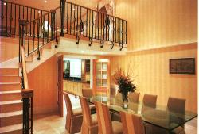

Slide 16
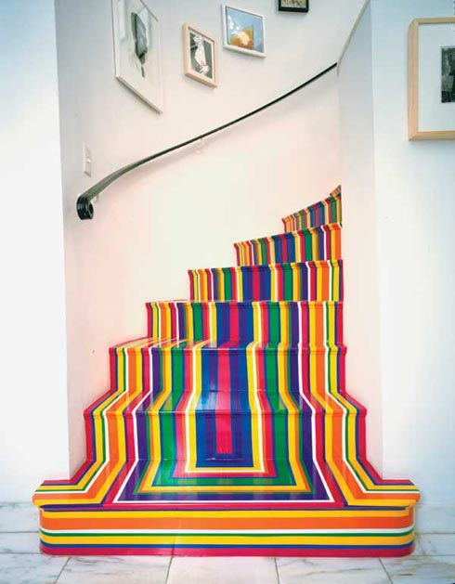

Slide 17
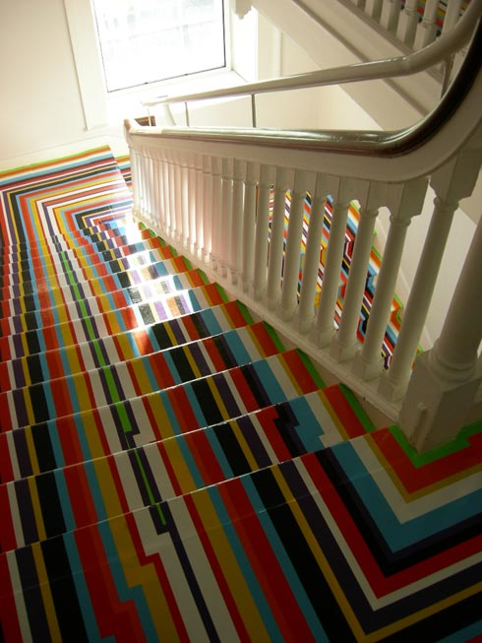

Slide 19
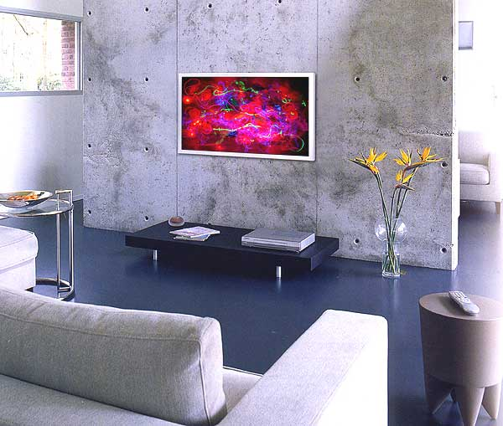

Slide 20
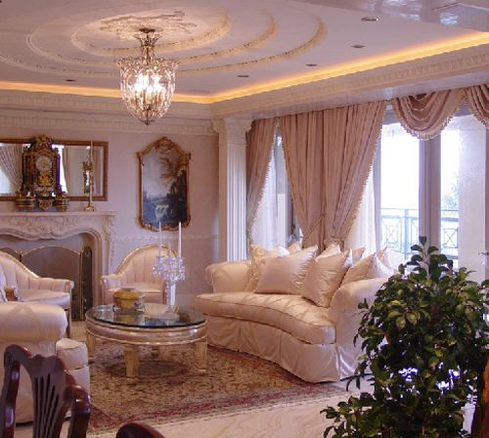

Slide 21
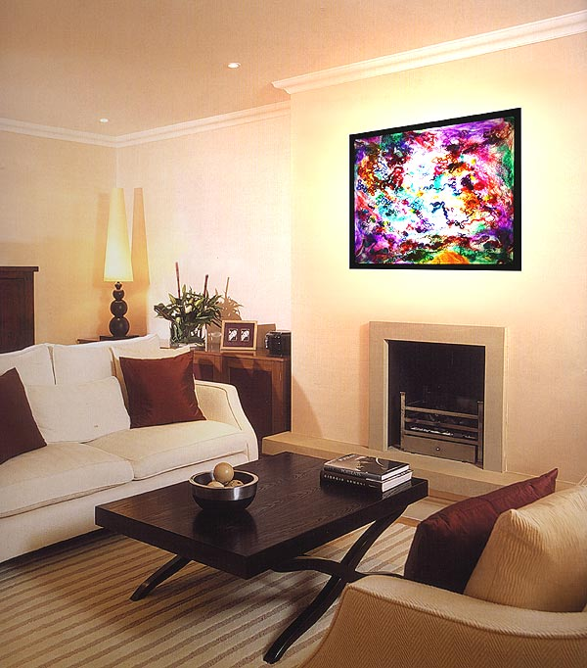

Slide 22
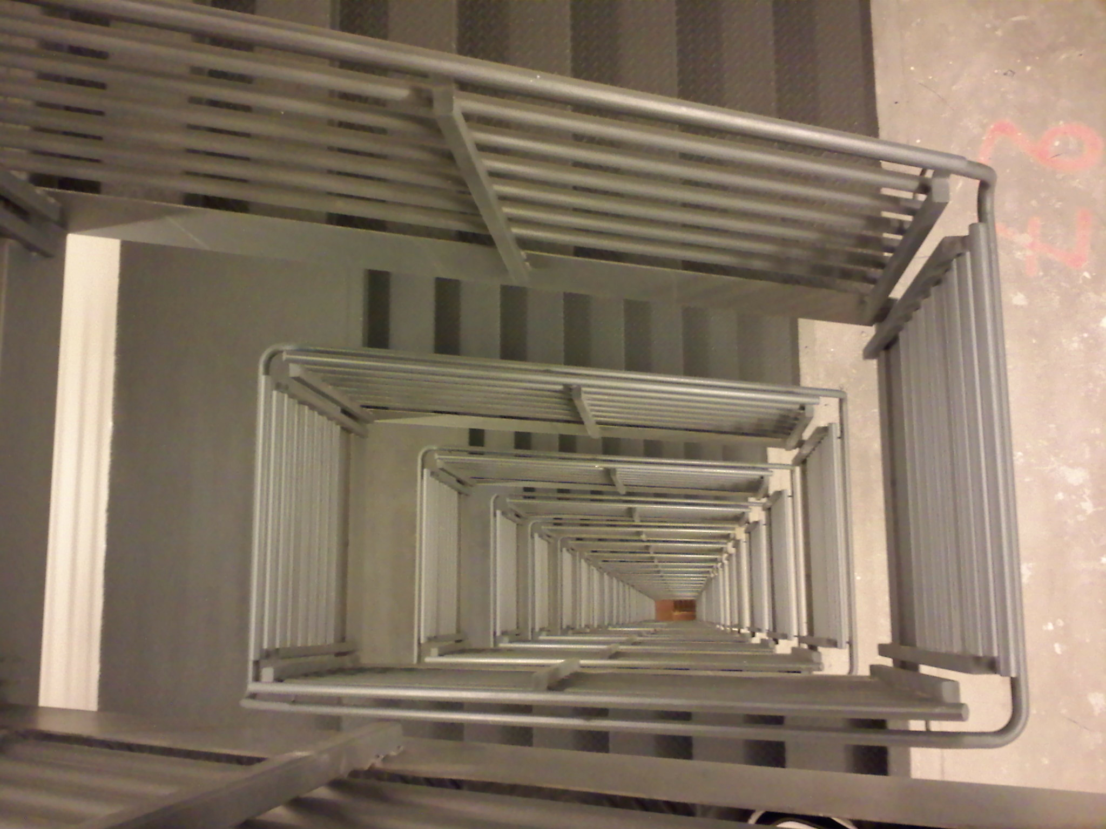

Slide 23
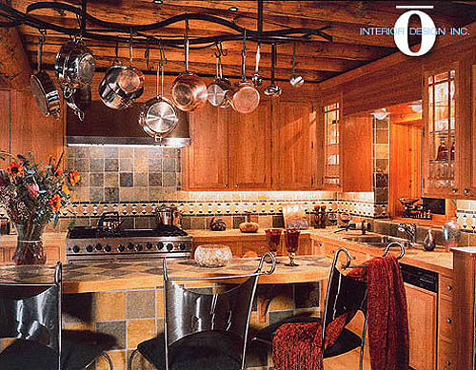

Slide 24
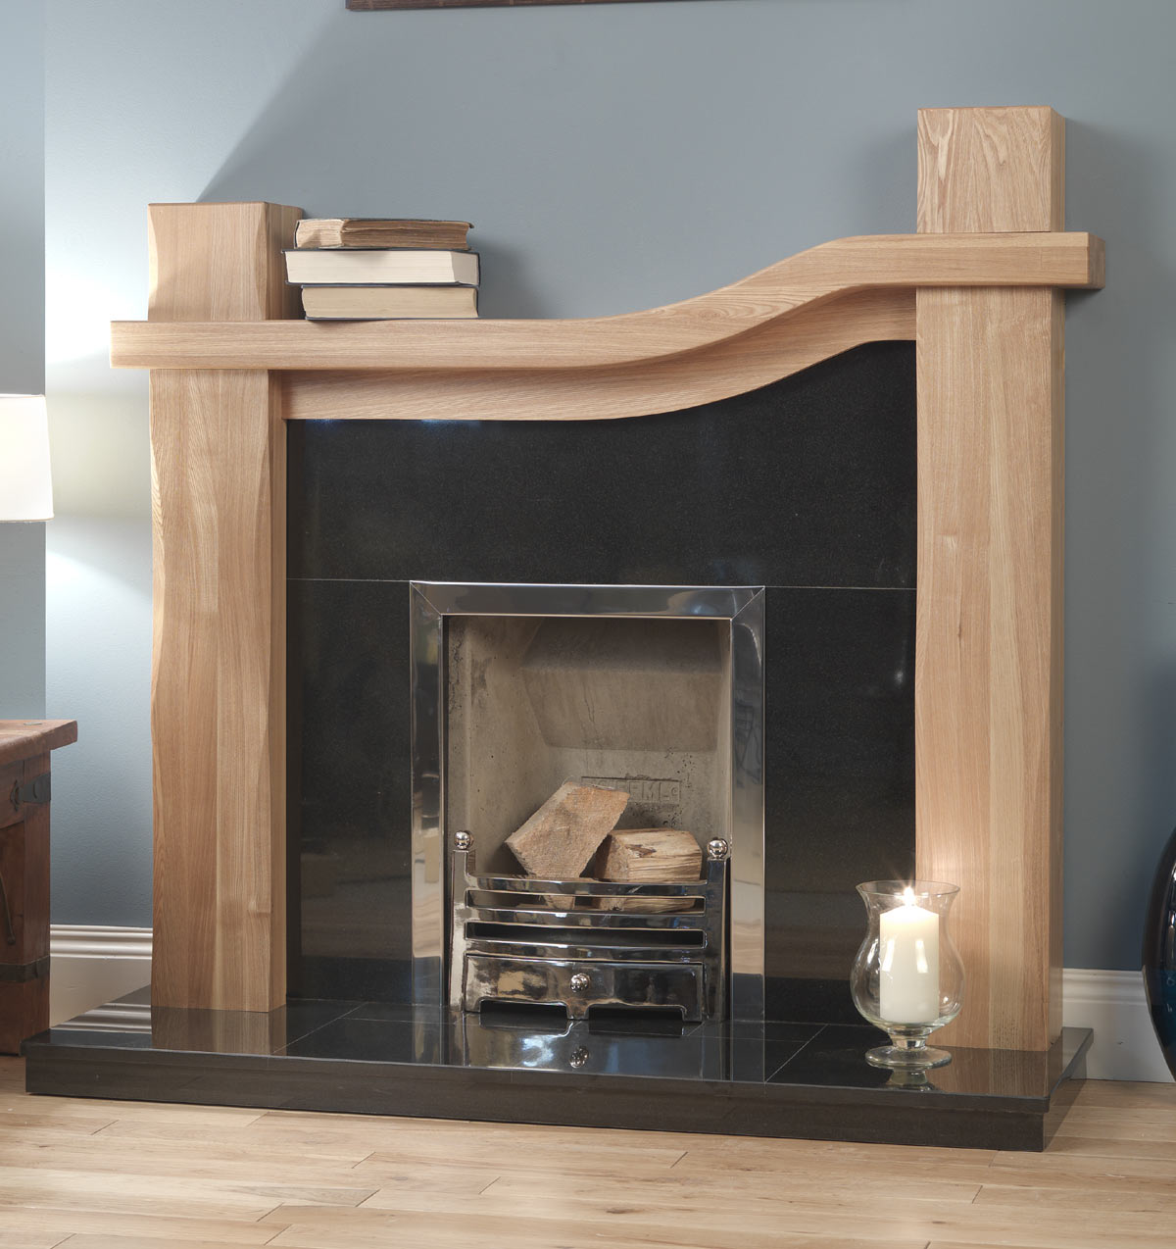

Slide 26
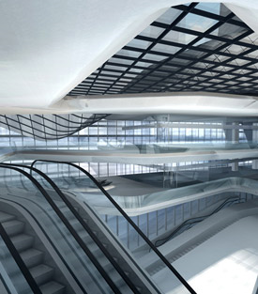

Slide 27
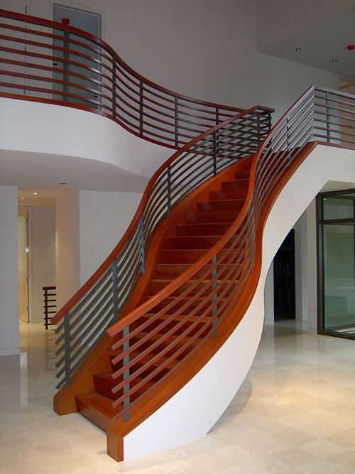

Slide 28
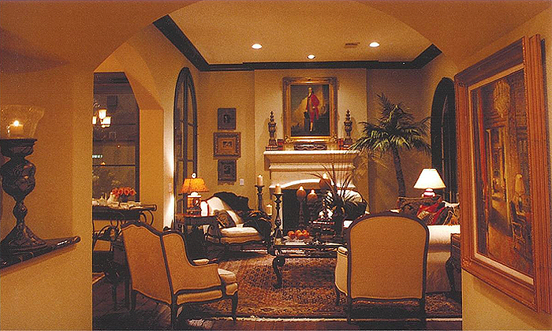

Slide 29
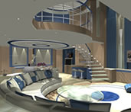

Slide 30
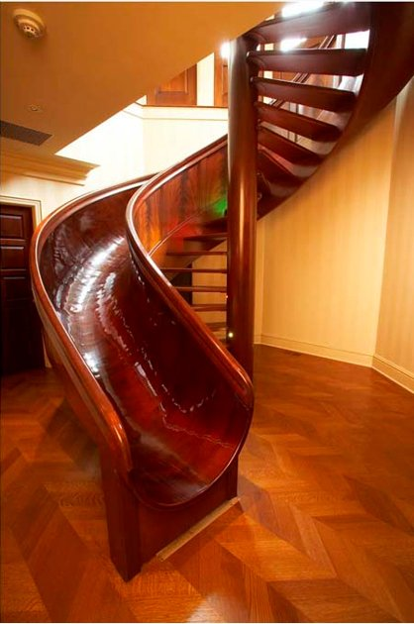

Slide 31
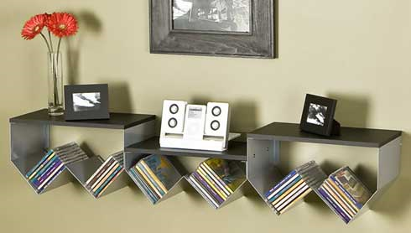
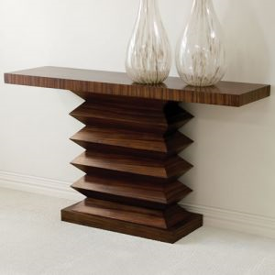

Slide 32
