Slide 1
Who Lives here?

Slide 2
Can you guess who lives in each of the following houses?

Slide 3
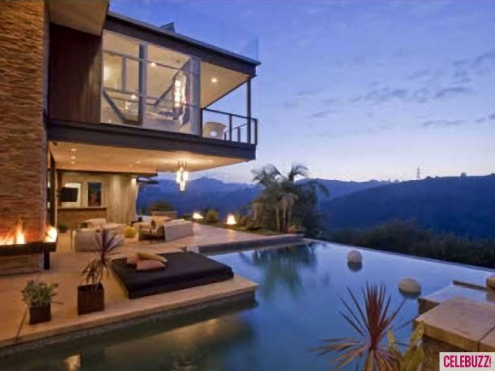
Justin Bieber

Slide 4
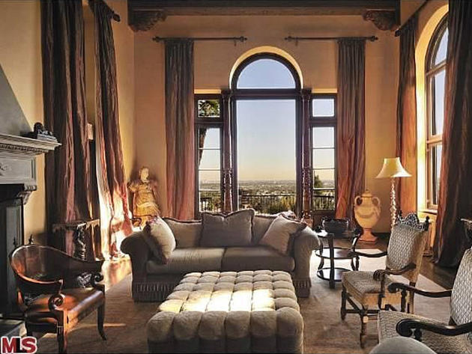
Katy Perry

Slide 5
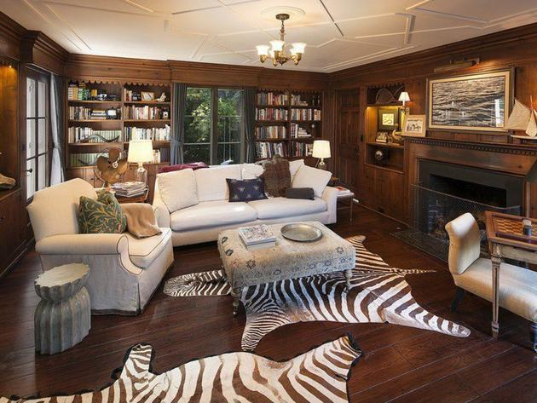
Drew Barrymore

Slide 6
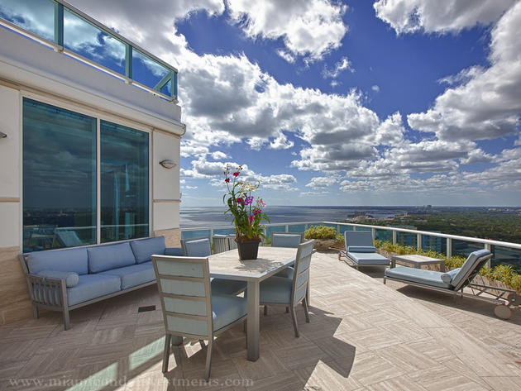
Pharrell Williams

Slide 7
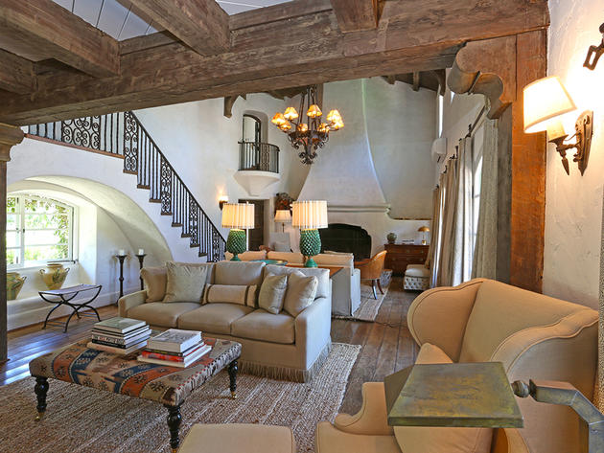
Reese Witherspoon

Slide 8
Kanye West

Slide 9
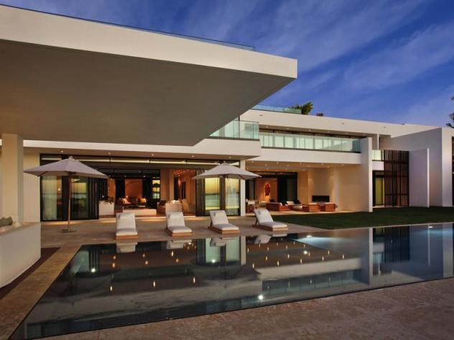
Alex Rodriguez

Slide 10
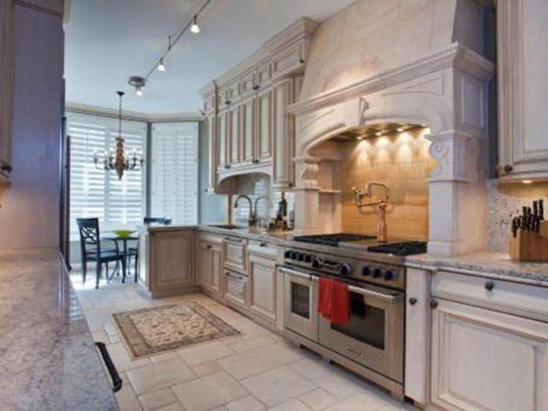
Oprah Winfrey

Slide 11
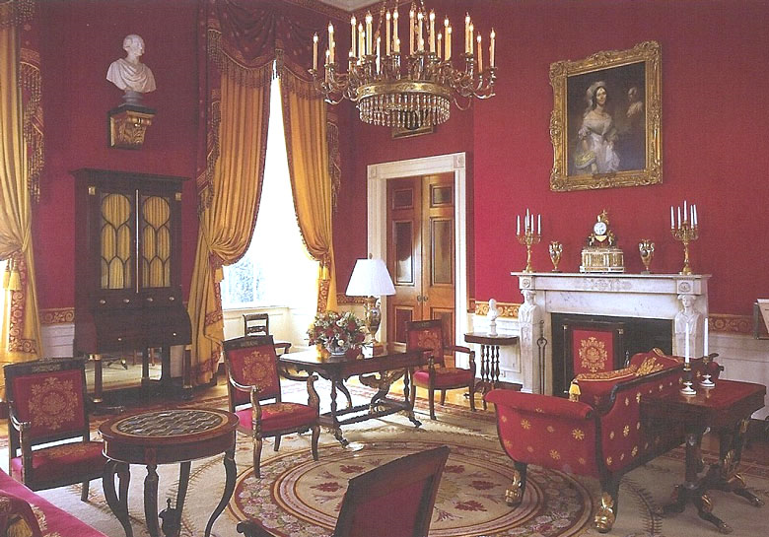
The President

Slide 12
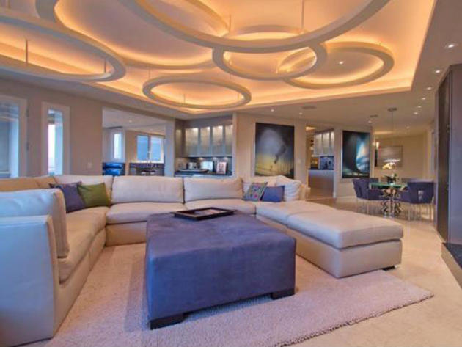
Dwayne “The Rock” Johnson

Slide 13
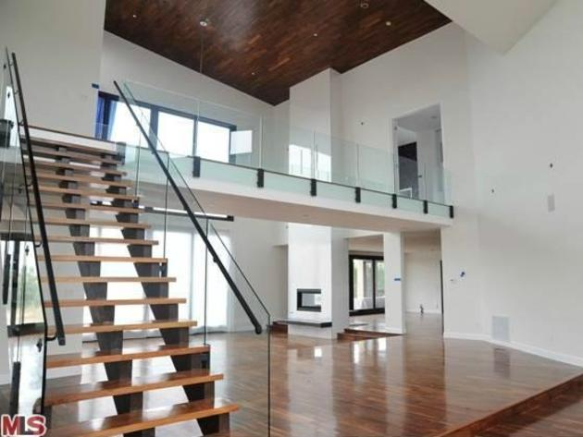
Rihanna

Slide 14
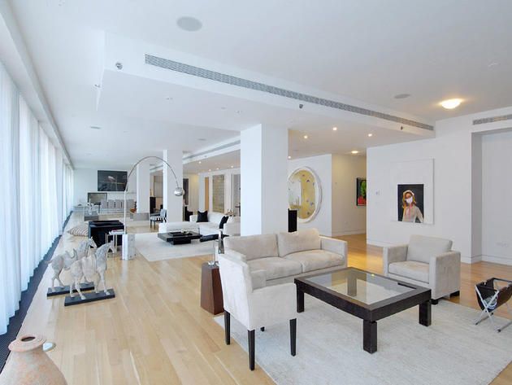
Will Smith

Slide 15
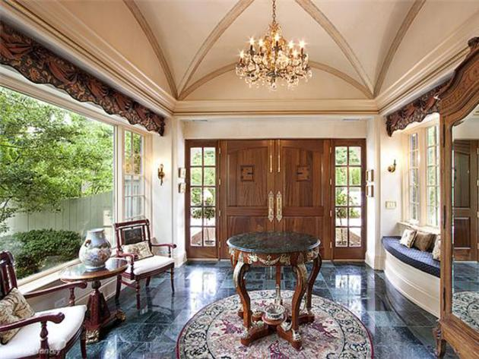
Taylor Swift

Slide 16
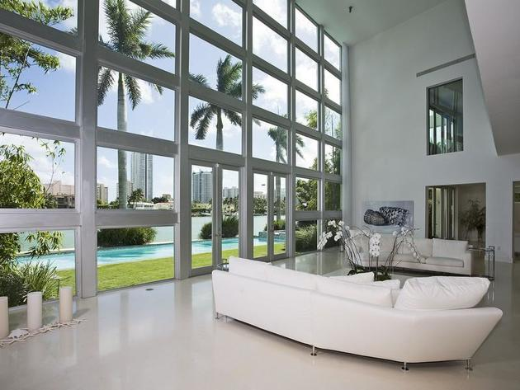
Lil Wayne

Slide 17
intro To Interior Design

Slide 18
Your Future Home
Imagine the home you want in the future:
Where will it be located? (Near mountains, the ocean, big city, etc.)
What will the climate be like where you live?
Describe the outside or the exterior of your future house will look like.
How big will your house be? How many bedrooms? How many bathrooms? How many people could live there?
What special or unique things will be in your house? (Swimming pools, library, slides, etc.)
Describe the inside or the interior of your future house. What colors will you use? What kind of furniture will you have?

Slide 19
Needs & Wants
List 3 activities families do in the home.
List 3 things families NEED in a home.
List 3 things families WANT in a home.
What’s the difference?

Slide 20
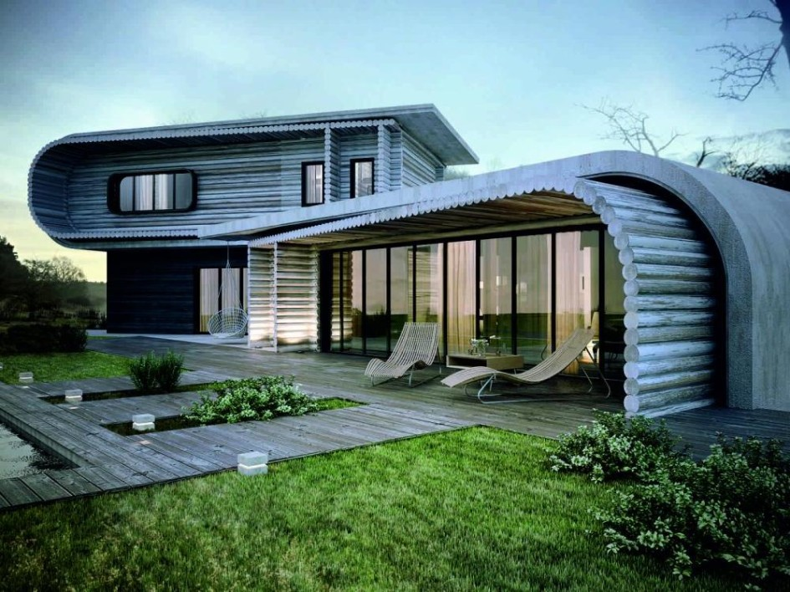
Function & Beauty
Homes can include everything a family NEEDS and WANTS, especially when it is designed around both FUNCTION and BEAUTY.

Slide 21
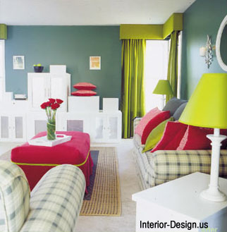
4. What is Interior Design?
The design of a functional and beautiful living environment.

Slide 22
5. How do we create a functional and beautiful living environment?
By carefully using the
Elements & Principles of Design

Slide 23
6. What are the elements of design?
Color
Line
Space
Shape & Form
Texture
Pattern

Slide 24
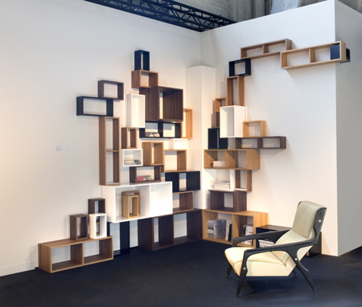
7. What are the principles of design?
There are 5 Principles of design:
Balance
Scale/ Proportion
Emphasis (Focal Point)
Harmony
Rhythm

Slide 25
8. How do they work together?
Elements are WHAT you use to decorate a room. Principles are HOW you use the elements to get the look you want.

Slide 26
Careers Related to Interior Design

Slide 27
1. Interior Designer

Slide 28
2. Architect

Slide 29
3. Contractor

Slide 30
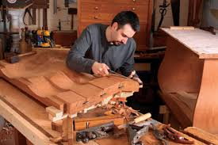
4. Furniture Craftsman

Slide 31
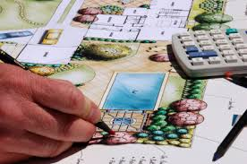
5. Landscape Architect

Slide 32
6. Set and Exhibit Designer

Slide 33
7. Art Director

Slide 34
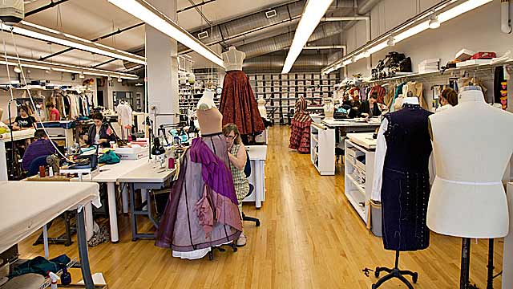
8. Costume Designer

