Slide 1
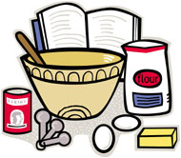
Cooking Terms

Slide 2
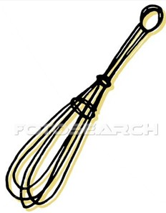
Bake
To cook by dry heat, usually in an oven.
2. Beat
To make a mixture smooth by lifting it over and over quickly with a big beating stroke or to incorporate air through the mixture. (Usually with an electric mixer or wire whisk.)

Slide 3
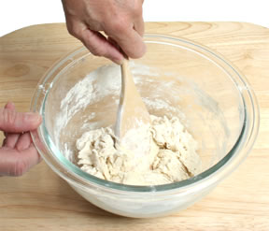
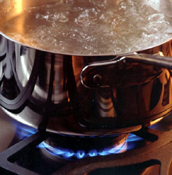
3. Blend
To mix two or more ingredients together until well combined.
4. Boil
To cook in water or other liquid in which bubbles rise continually and break on surface.

Slide 4
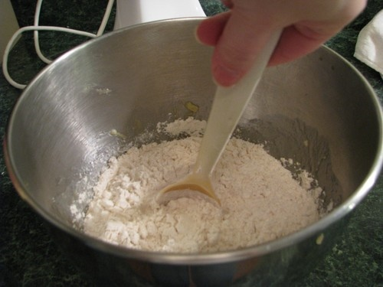
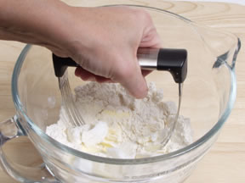
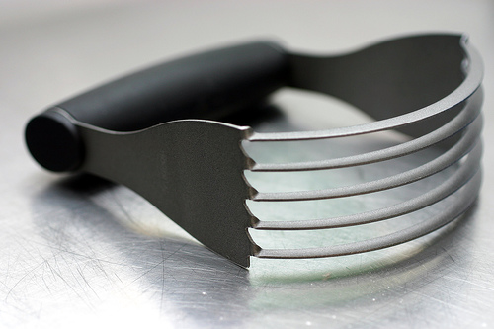
5. Cream
To work sugar and fat together until the mixture is soft and fluffy.
6. Cut-In
To cut fat into flour with two knives or a pastry blender.

Slide 5
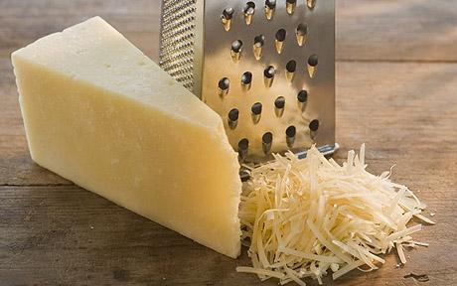
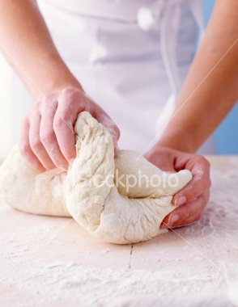
7. Grate
To rub food on a surface with sharp projections.
8. Knead
To work dough by pressing and folding until it becomes elastic and smooth.

Slide 6
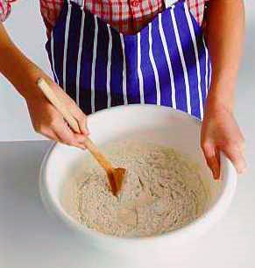
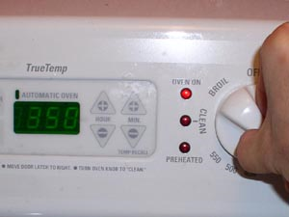
9. Mix
To combine ingredients together, usually by stirring.
10. Preheat
To heat an oven prior to using in order to obtain the correct cooking temperature.

Slide 7
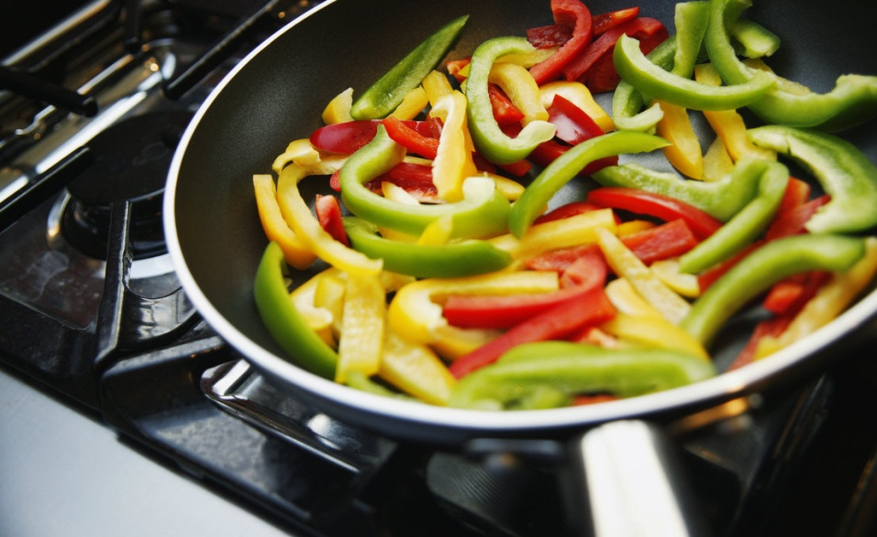
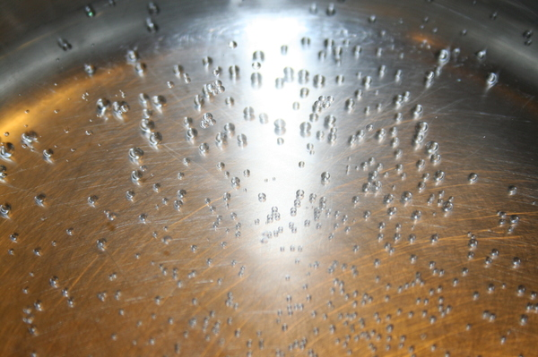
11. Saute
To brown or cook food in a small amount of fat.
12. Simmer
To cook food just below the boiling point.

Slide 8
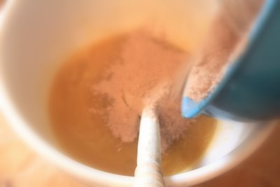
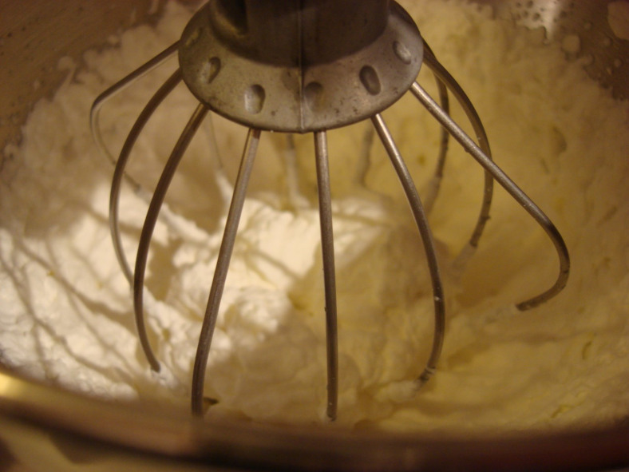
13. Stir
To mix by using a circular motion, going around and around, until the food is blended together.
14. Whip
To beat rapidly to incorporate air and to increase volume.

Slide 9
Equivalents & Abbreviations
T., Tbsp., or tbsp. = tablespoon
t., or tsp. = teaspoon
Min. = minute
Oz. = ounce
Qt. = quart
Pt. = pint
Gal. = Gallon
Hr. = hour
Doz. = dozen
C. = cup
lb. or # = pound
Pkg. = package

Slide 10
Mrs. T. and Her Babies
Helpful Hints:
T. = Tablespoon
t. = teaspoon
Mrs. T. has 3 baby t.’s
There are 3 little t.’s with 1 big T.
Equivalents To Remember:
1 Tablespoon = 3 teaspoons
1/2 Tablespoon = 1 ½ teaspoons

Slide 11
Young T. and Cousin Oz.
Helpful Hints:
Young T. just got his drivers license-He is 16 (16 Tablespoons)
He now gets to drive the “Cup Car” (1 Cup)
Cousin Oz. is half as old as Young T.-He is only 8 (8 Ounces)
It takes 8 ounces to fill up the “Cup Car” (8 oz. = 1 c.)
Equivalents To Remember:
8 Ounces = 1 Cup
1 Cup = 16 Tablespoons
3/4 Cup = 12 Tablespoons
1/2 Cup = 8 Tablespoons
1/4 Cup = 4 Tablespoons
1/8 Cup = 2 Tablespoons
Young T.
Cousin Oz.
Cup Car

Slide 12
GAL the Butterfly
Helpful Hints:
GAL stands for Gallon
GAL’s wings are so QT! (Quart)
4 Wings = 4 Quarts
Small Circles Represent 1 C.
Equivalents To Remember:
4 Cups = 1 Quart
4 Quarts = 1 Gallon
16 Cups = 1 Gallon

Slide 13
The Cup Kids
Helpful Hints:
Each Kid represents 1 cup
Equivalents To Remember:
2 Cups = 1 Pint
2 Pints = 1 Quart
4 Cups = 1 Quart

Slide 14
Other Important Equivalents To Remember
1 stick of butter/margarine = 1/2 cup
5 Tbsp. + 1 tsp. = 1/3 cup
8 oz. = 1 c.
16 oz. = 1 lb.

