Slide 1
The Six Basic Nutrients &
Intro to MyPlate

Slide 2

What is a Nutrient?
Substances found in food that are essential for growth and energy
There are SIX basic essential nutrients:
  Carbohydrates
  Protein
  Fat
  Vitamins
  Minerals
  Water

Slide 3
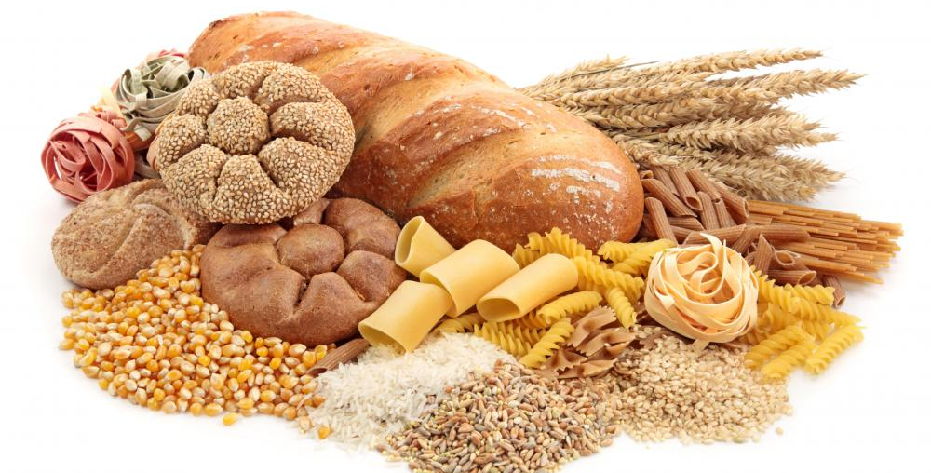
Carbohydrates
Main Function: To provide our bodies with energy
Healthy Food Sources: whole grains, cereals, beans, rice, pasta

Slide 4
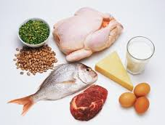
Protein
Main Function: To build and repair body tissues
Healthy Food Sources: meat, poultry, eggs, seafood, milk/milk products, cheese , nuts/seeds

Slide 5
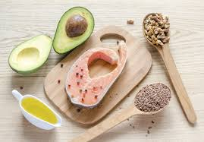
Fat
Main Functions: Provides “back-up” energy, protects internal organs, promotes healthy skin, carries vitamins through the body
Healthy Food Sources: olive oil, canola oil, avocados, olives, flaxseed, nuts, tofu, fatty fish (salmon, tuna, trout)

Slide 6
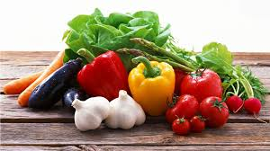
Vitamins
Main Functions: To regulate body functions (nerves, muscles and skin functions)
Healthy Food Sources: Fruits and vegetables (especially red, orange and dark green), enriched grains, dairy products

Slide 7
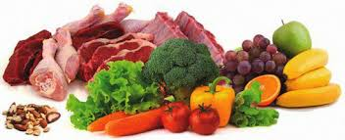
Minerals
Main Functions: To regulate body functions (strong bones and teeth, maintaining fluid balance in the body)
Healthy Food Sources: Fruits and vegetables (especially red, orange and dark green), dairy products, animal products

Slide 8

Water
Main Functions: Prevents dehydration, carries vitamins through the body, carries waste products out of the body, regulates body temperature
Healthy Food Sources: Water

Slide 9
What is MyPlate?
MyPlate is the current nutrition guide from the USDA that is meant to help people develop a healthy diet.
MyPlate is broken into FIVE food groups.

Slide 10
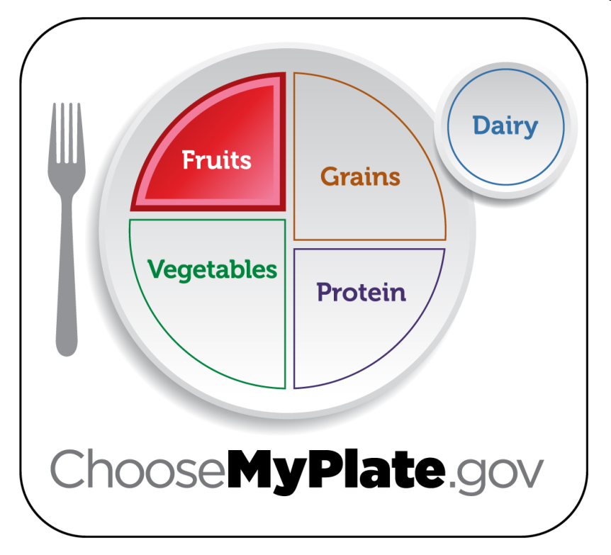
Fruits Group
Key Consumer Message: Make half your plate fruits and vegetables.
2. Major Nutrients Found in the Fruits Group: Vitamins, Minerals
Other Tips: Use fruits as snacks, salads or desserts. Choose whole or cut up fruits more often than fruit juice.

Slide 11
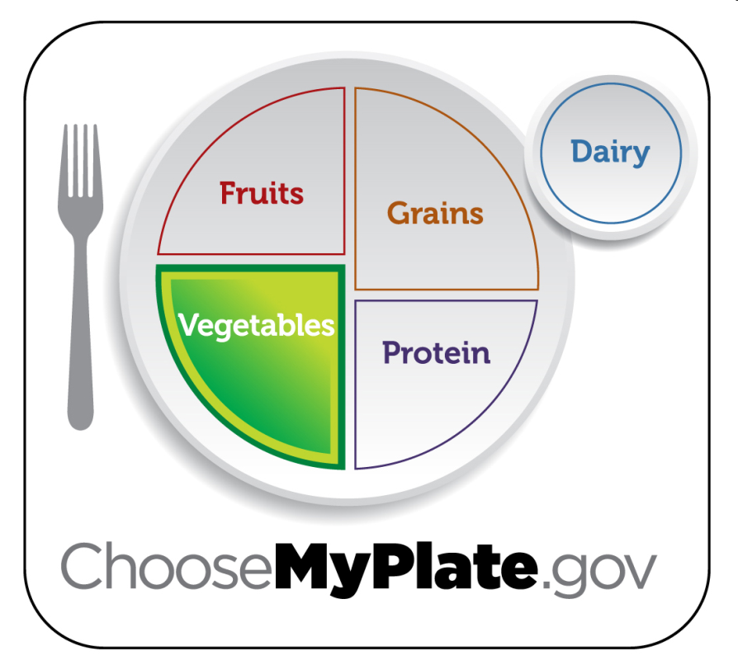
Vegetables Group
Key Consumer Message: Eat red, orange and dark green vegetables.
2. Major Nutrients Found in the Vegetables Group: Vitamins, Minerals
Other Tips: Choose fresh, frozen, canned or dried vegetables.

Slide 12
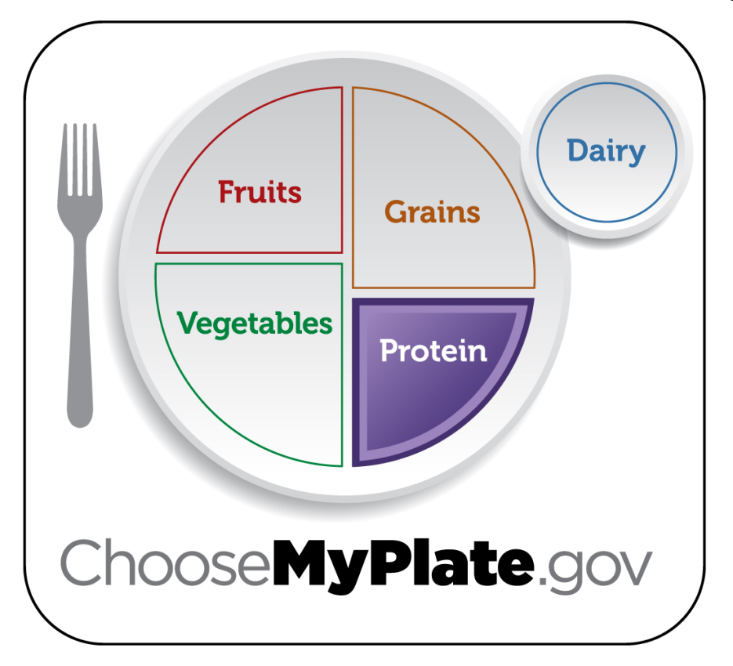
Protein Group
Key Consumer Message: Keep meat and poultry portions small and lean.
2. Major Nutrients Found in the Protein Group: Protein, Minerals, Fat
Other Tips: Choose a variety of different protein sources. Choose 8 ounces of seafood per week. Try grilling, broiling, poaching or roasting.

Slide 13
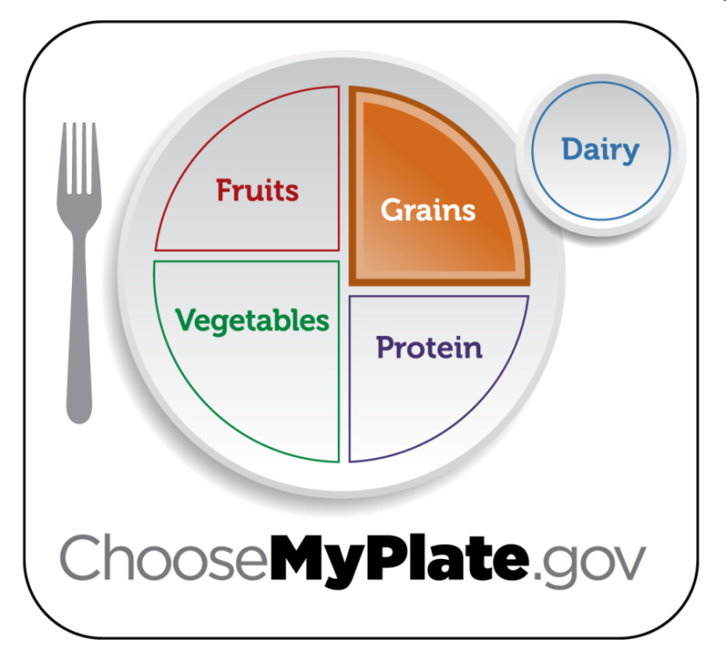
Grains Group
Key Consumer Message: Make half your grains whole grains.
2. Major Nutrients Found in the Grains Group: Carbohydrates
Other Tips: Choose 100% whole grain cereals, breads, crackers, rice and pasta. Check the ingredients list on food packages to find whole grain foods.

Slide 14
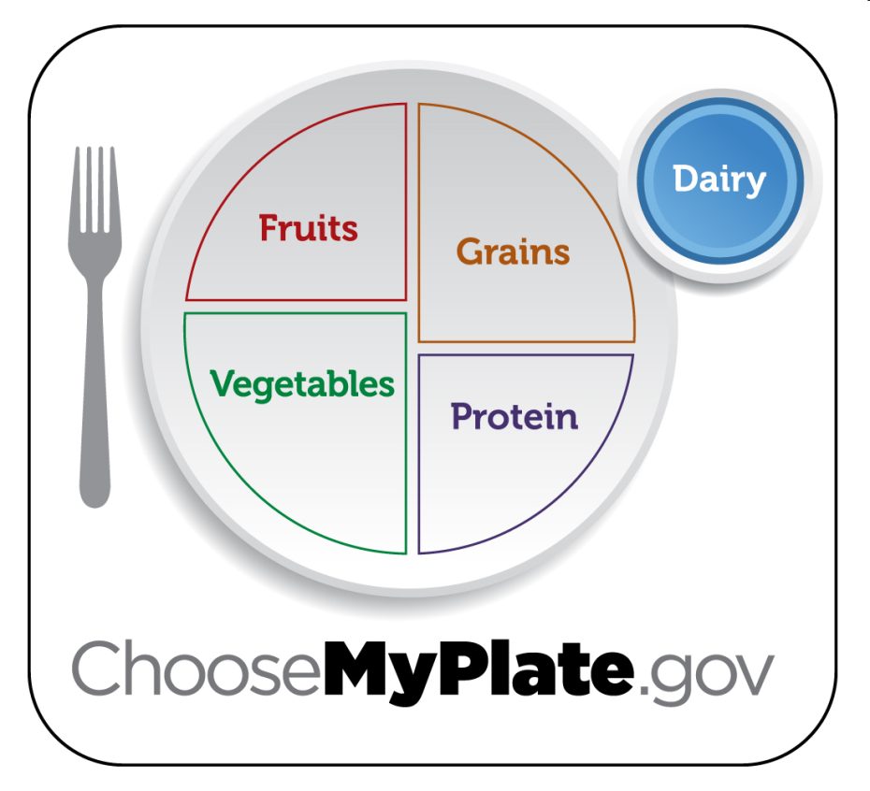
Dairy Group
Key Consumer Message: Switch to low-fat or fat-free milk. Get your calcium rich foods.
2. Major Nutrients Found in the Dairy Group: Protein, Fat, Vitamins, Minerals
Other Tips: Low-fat or fat-free dairy products have the same amount of calcium and other essential nutrients as whole milk, but less fat and calories.

Slide 15
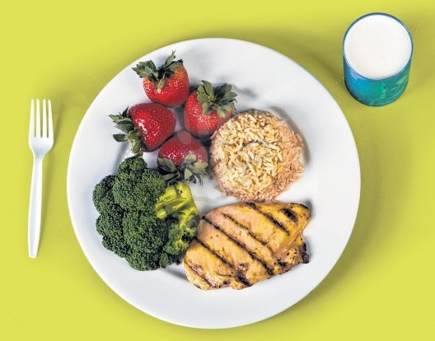
Important Healthy Eating Tips

Slide 16
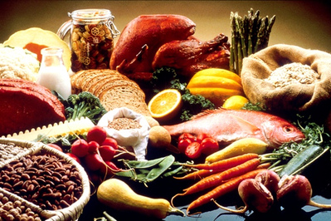
5. Choose Foods that Are Nutrient Dense
Nutrient Dense: Foods that have a lot of important nutrients, but few calories.
  Choosing foods that are nutrient dense are better for your overall health.

Slide 17

6. Avoid Eating Too Many Empty Calories
Empty Calories: Foods that have a lot of solid fats, sugar and calories, but few important nutrients.
  In some foods, like candies and sodas, ALL of the calories are empty calories.

Slide 18


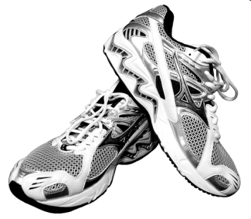
7. Balance Calories to Manage Weight
Control total calorie intake to manage body weight.
Intake
Output

Slide 19

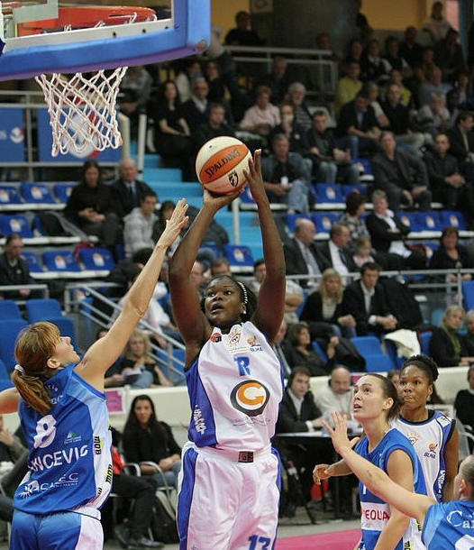
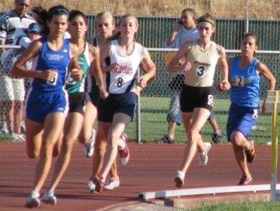


8. Increase
Physical Activity
Teens should be active at least 60 minutes or more each day.

Slide 20

9. Reduce Screen Time
Spend less time in front of the TV, video games and phones and more time being physically active.

Slide 21

10. Enjoy Your Food,
But Eat Less
Avoid oversized portions.

Slide 22

Careers Related to
Foods and Nutrition

Slide 23

Executive Chef

Slide 24

Pastry Chef

Slide 25

Food Service Worker

Slide 26

Dietitian / Nutritionist

Slide 27

Food Science Researcher

Slide 28
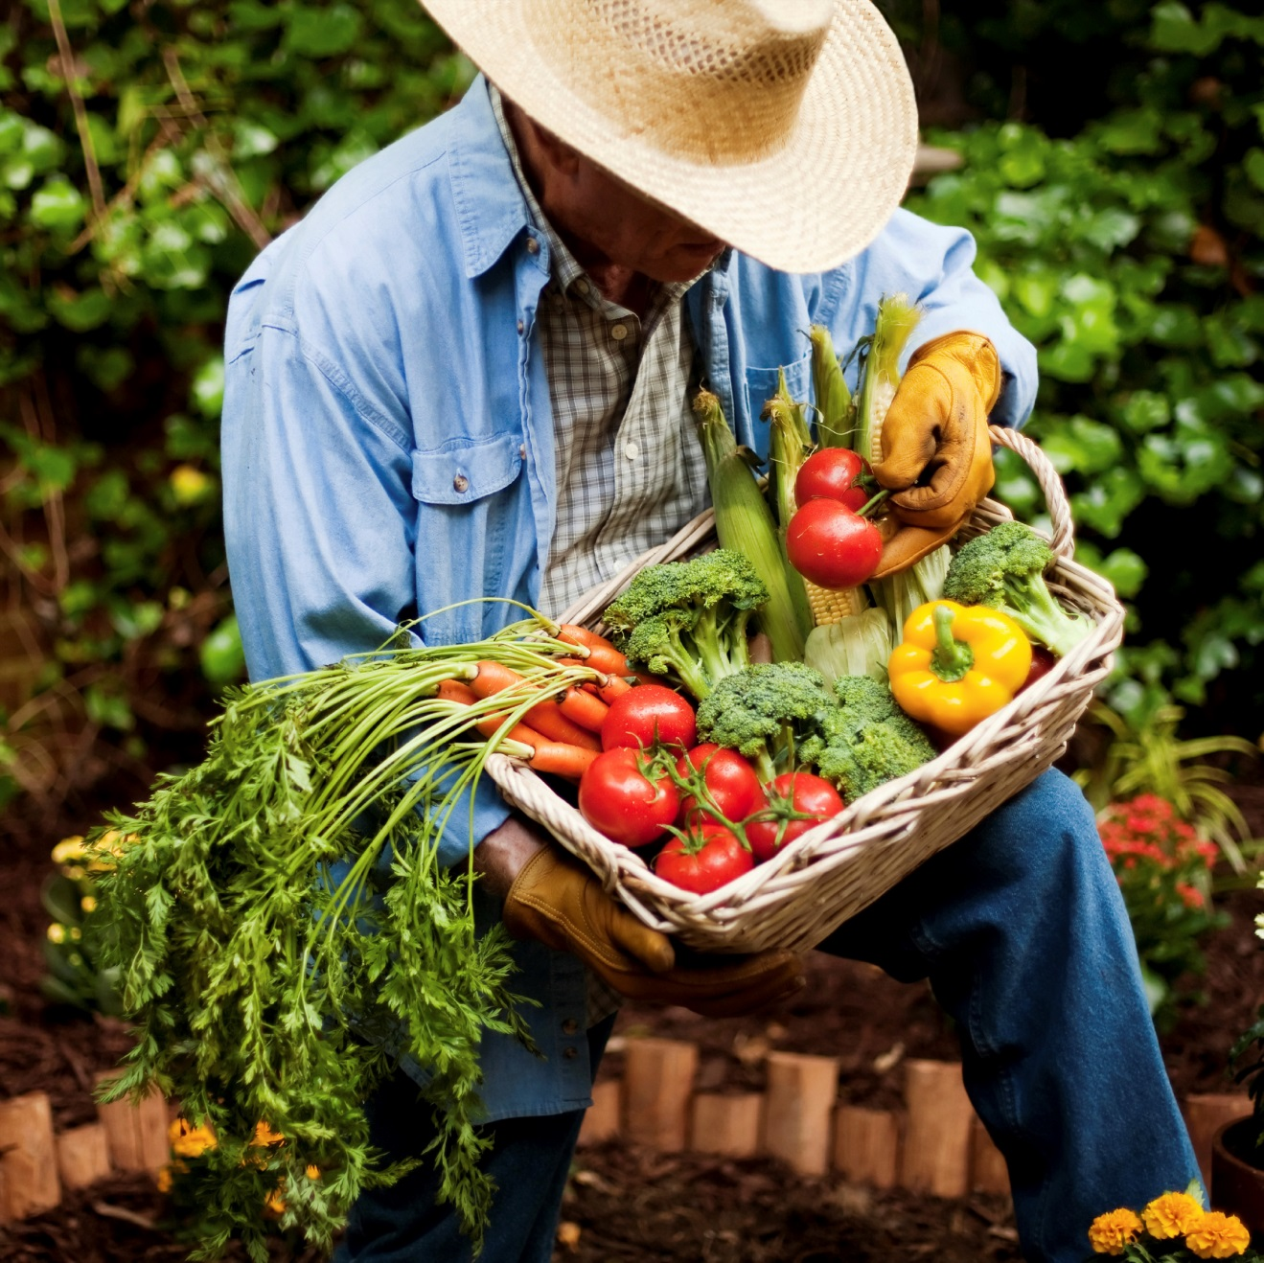
Agriculturalist

Slide 29

Caterer

Slide 30

Personal Trainer /
Health Coach

