Slide 1
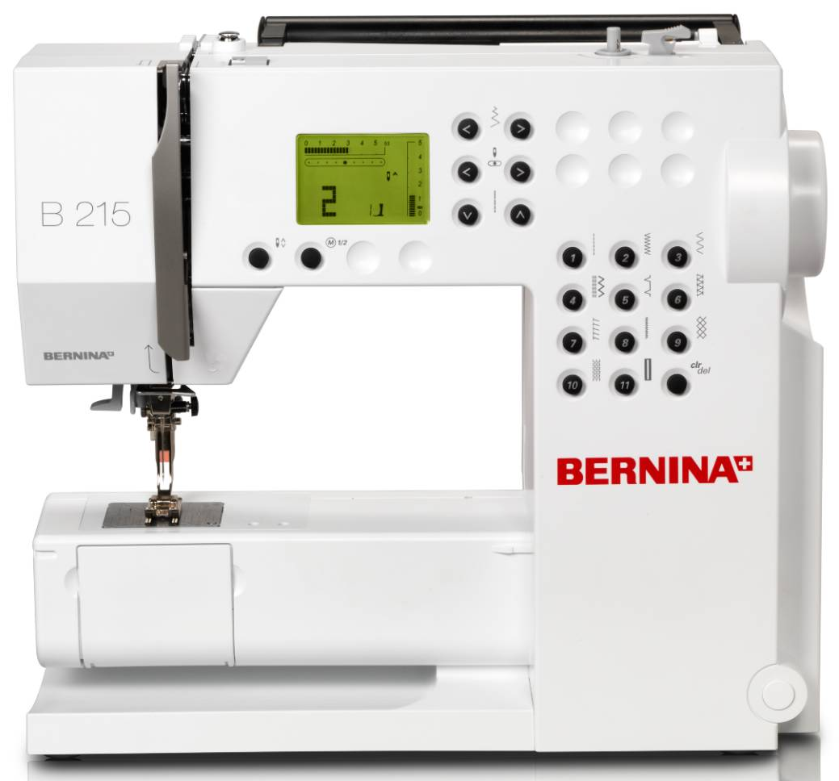
Intro to the Sewing Machine

Slide 2

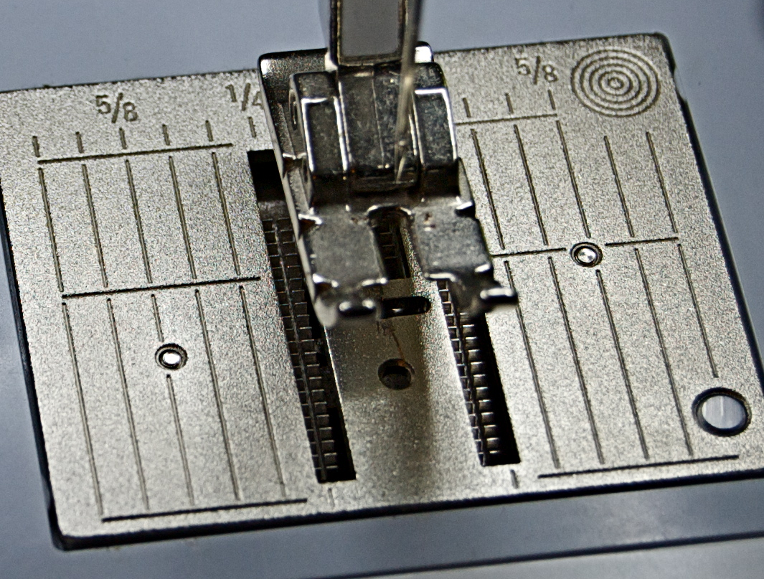
1. Stitch Plate
Where the seam allowance guidelines are found.
Each line is 1/8” apart, beginning with the inside edge of the presser foot, and ending with the far right edge of the stitch plate.

Slide 3
1/8
Inside Edge of the Presser Foot = __________”
(No Line On the Stitch Plate)

Slide 4
1/4
Outside Edge of the Presser Foot = __________”
(First Small Line)

Slide 5
3/8
First Long Line = __________”

Slide 6
1/2
Second Long Line = __________”

Slide 7
5/8
Third Long Line = __________”

Slide 8
3/4
Fourth Long Line = __________”

Slide 9
7/8
Fifth Medium Line = __________”

Slide 10
1
Right Edge of the Stitch Plate= _______”

Slide 11
2. Feed Dogs
Toothed metal piece below the stitch plate that moves up and down to push the fabric along beneath the needle.

Slide 12
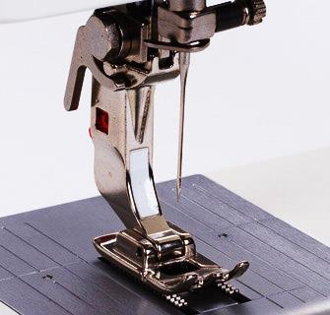
3. Presser Foot
Holds the fabric down against the feed dogs to move the fabric evenly through the machine.
There are several different types of presser feet, each designed to make a particular sewing task easier.

Slide 13
4. Machine Needle
The upper thread is threaded through the machine needle.
There are several different types of machine needles for different types of fabric and sewing techniques.

Slide 14
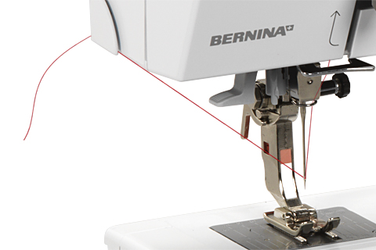
5. Thread Cutter
Cutting tool on the left side of the sewing machine that allows for easy thread trimming.

Slide 15
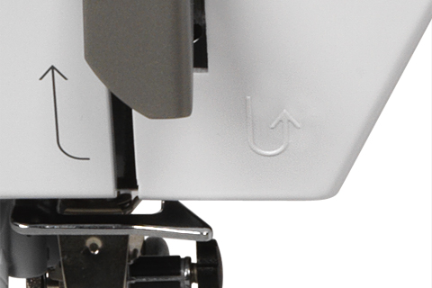
6. Backstitch Button
When pushed in, it allows you to sew backwards until it is released.

Slide 16
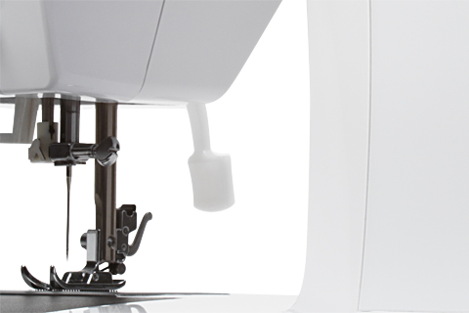
7. Presser Foot Lever
Raises and lowers the presser foot. It is found on the back of the machine.

Slide 17
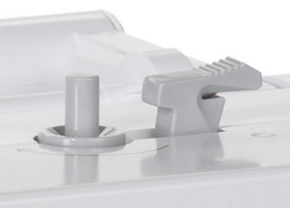
Bobbin Stop
Bobbin Winder
Thread Cutter
8. Bobbin Winder and Bobbin Stop
Winds the thread around the bobbin.
There is another thread cutter on the side
of the bobbin stop.

Slide 18
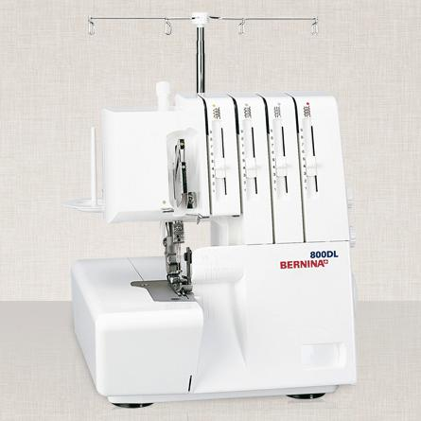
Using the Serger
Some advantages of using a serger include:
  Cuts off excess fabric as it sews.
  Fastest way of finishing a seam.
2. The three rules of serging are:
  Keep your fingers away from the knife.
  Don’t lift up the presser foot.
  Leave a “thread tail” behind when finished.
  3. Do not serge over pins, zippers or excessive bulk.

Slide 19
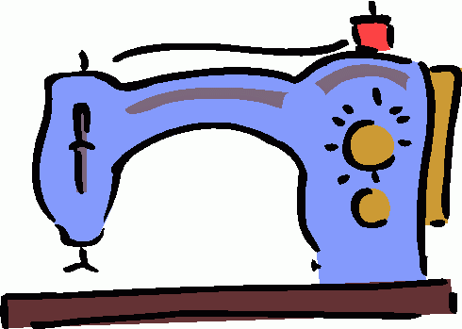
Sewing Equipment

Slide 20
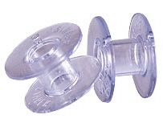
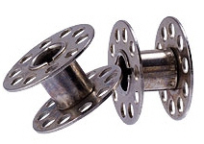
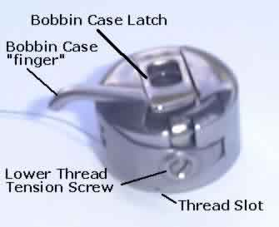
1. Bobbin
A small spool, made of plastic or metal, around which the lower thread of the sewing machine is wound.
2. Bobbin Case
The part of the sewing machine that holds the bobbin.

Slide 21
3. Measuring Tape
Flexible piece of equipment used to measure body measurements, grainlines and long distances.

Slide 22
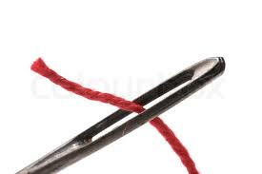
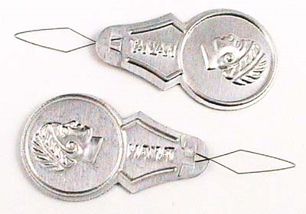
4. Needle
A small, slender piece of metal with a sharp point at one end ad a hole, or “eye” at the other. Used for hand sewing.
5. Needle Threader
A small piece of equipment used to pull thread through the eye of a hand needle.

Slide 23
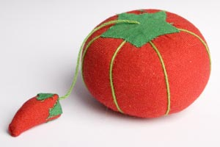
6. Pin Cushion
Small cushion used to hold and sharpen straight pins.
7. Pins
Holds layers of fabric together for cutting and sewing.

Slide 24
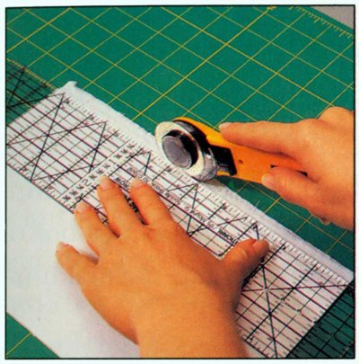
8. Rotary Cutting Equipment
Equipment used to cut very straight, clean lines in fabric. Never use the rotary blade without the ruler or the cutting mat.
Rotary Mat
Rotary Ruler
Rotary Cutter

Slide 25
9. Seam Gauge
Metal six-inch ruler with a sliding marker.
10. Seam Ripper
Useful tool that helps unpick small stitches.

Slide 26
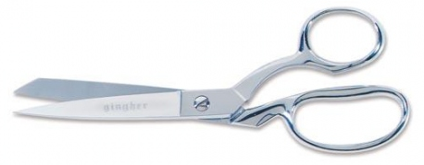
11. Shears
Sharp cutting tool to be used ONLY on fabric.

Slide 27
Sewing Terms

Slide 28
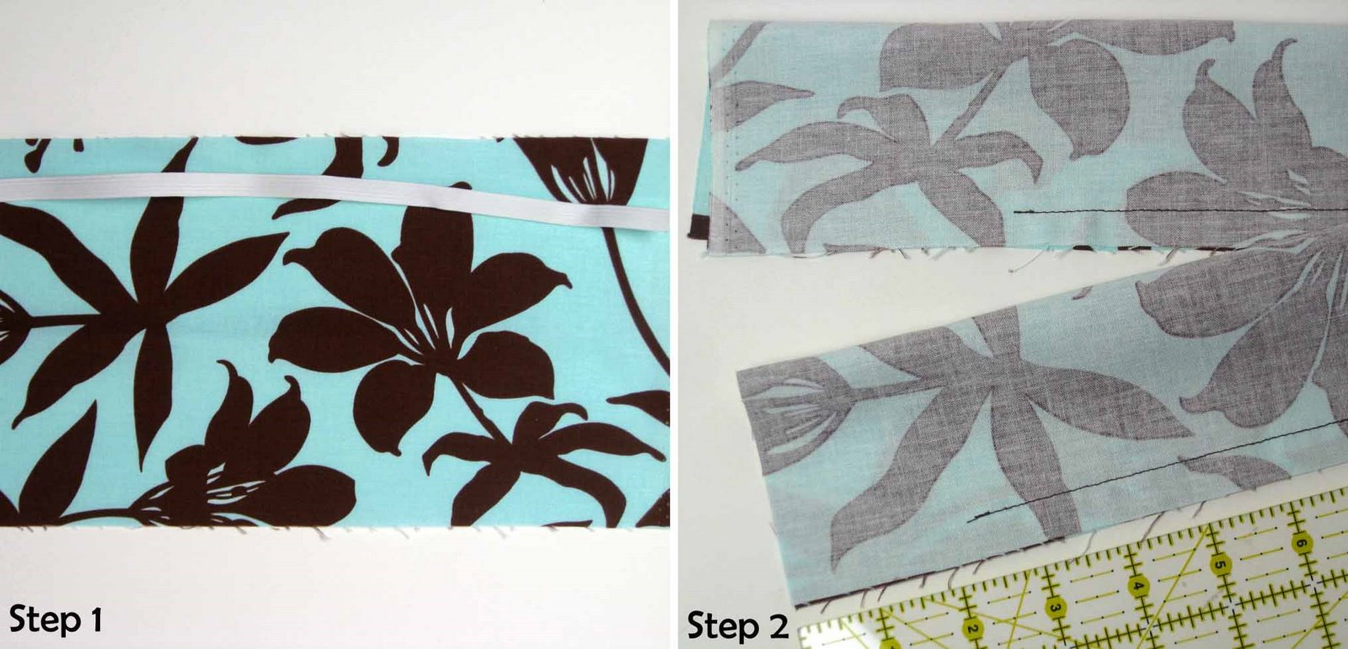
1. “Right” Side
The patterned side of fabric that will be showing when you are done sewing your project. Sometimes called the “Pretty” side.
“Right” Side
“Wrong” Side

Slide 29
2. “Wrong” Side
The back side of fabric that will be on the inside of the project you are sewing. Sometimes called the “Ugly” side.
“Right” Side
“Wrong” Side

Slide 30
3. Backstitch
To machine stitch two or three stitches BACKWARDS on the same line at the beginning and end of a seam to secure the stitches.

Slide 31
4. Notches
Diamond shaped symbols that extend beyond the cutting line on the pattern. They are used to match up pattern pieces.
5. Place-On-Fold Line
An arrow with bent corners to indicate pattern must be placed and cut on a folded edge of fabric.

Slide 32
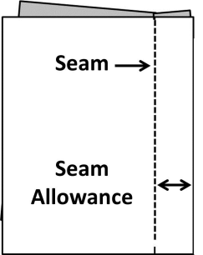
6. Seam
The stitched line that is created by sewing.
7. Seam Allowance
The distance between the edge of the fabric and the stitched line.

Slide 33
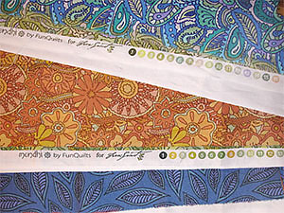
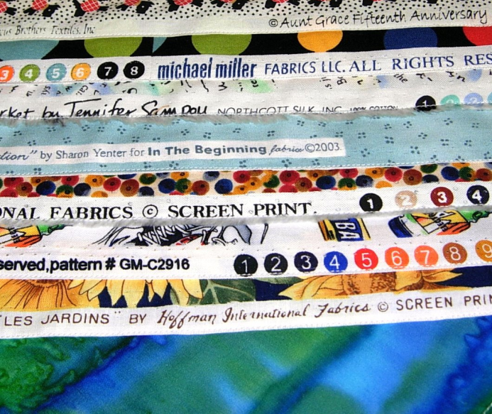
8. Selvage
The tightly woven edges on fabric that runs lengthwise down the fabric.
They should be touching when folded.
Selvage

Slide 34
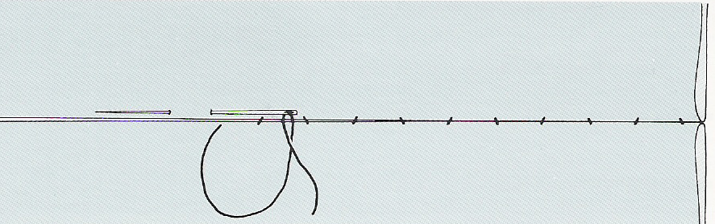
9. Slipstitch/Blind Stitch
A hand stitch that is almost invisible on both the right and the wrong side of the project.

Slide 35
Careers Related to Clothing and Textiles

Slide 36
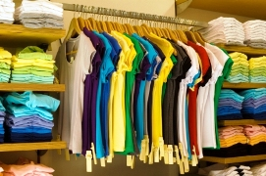
Apparel Production & Distribution

Slide 37
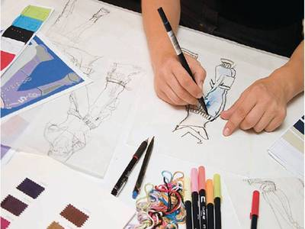
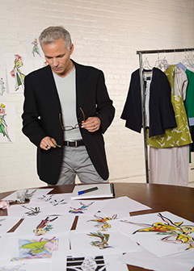

Fashion Designer

Slide 38
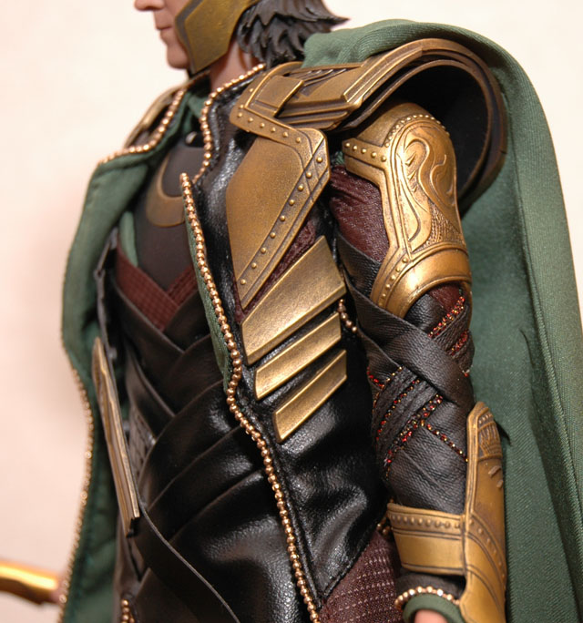
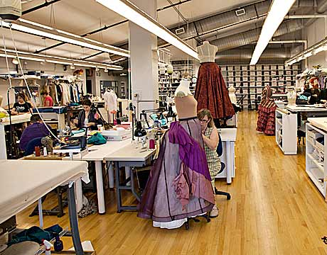
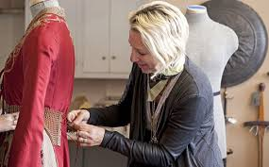

Costume Designer

Slide 39

Fashion Merchandiser

Slide 40
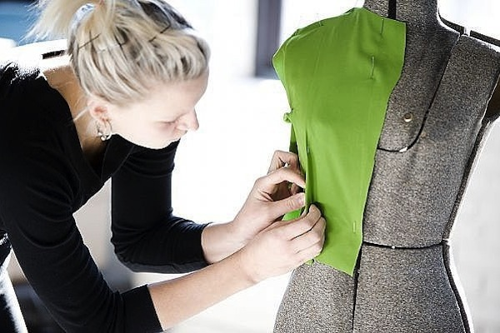
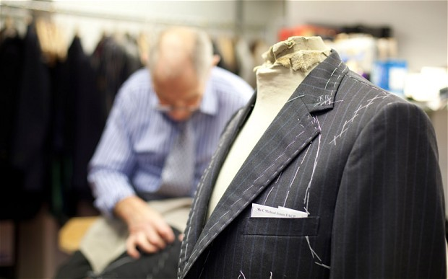
Seamstress / Tailor

