Slide 1
What is Color?
The reflection of light
Primary colors: Red, Yellow and Blue
Secondary colors: Made by mixing equal parts of two primary colors. Green, Violet, and Orange
Complimentary colors: Opposite colors on the color wheel. Red/Green, Yellow/Violet, Blue/Orange.
Tertiary colors: Made by mixing a primary and a secondary color. Yellow-green, Blue-green, Blue-violet, Red-violet, Red-orange, & Yellow-orange

Slide 2
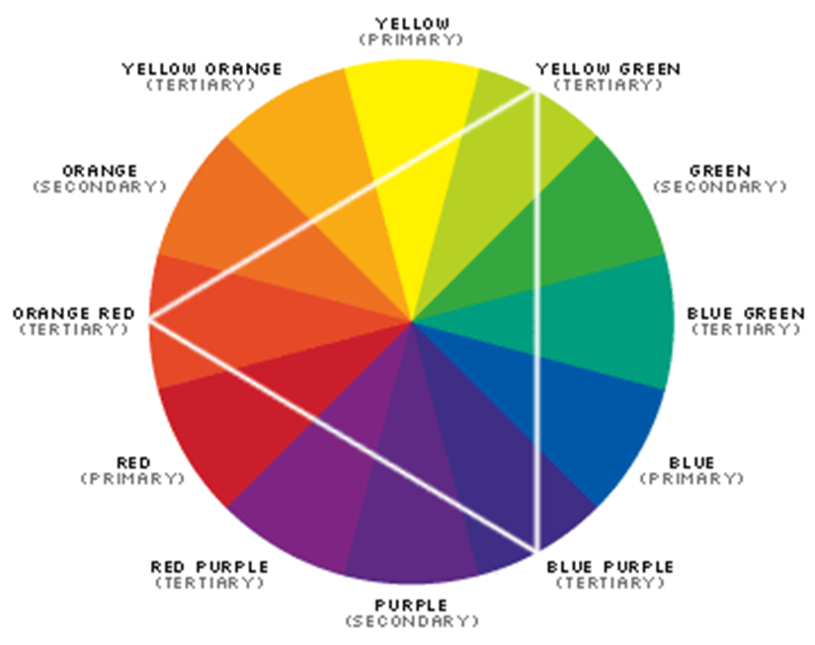
Color Wheel
The color wheel is made up of twelve colors
It is used to organize colors.
To visualize color relationships.
You can identify colors that go well together.
Using colored pencils color in the colors of the color wheel.

Slide 3
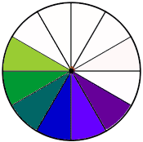
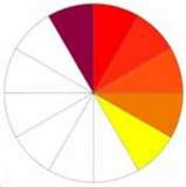
Warm Colors and Cool Colors
Color has temperature and it can effect the way we feel in a room.
Cool Colors recede away from us, make spaces feel larger and create cooler, calming and relaxing spaces.
Warm Colors advance towards us, make spaces feel cozier, create feelings of warm, activity and excitement.
The color used in a room can change the psychological temperature in a room up to 5 degrees.

Slide 4
Create a Color Wheel.
Using the color wheel provided
Label each color around the outside of the color wheel.
Then mix the primary colors to create each of the secondary and tertiary colors.
Paint each of the colors in the appropriate space.
Allow it to dry

Slide 5
Color Schemes

Slide 6
Monochromatic
Uses tints and shades of a single hue.
The main tint or shade should be easy to live with, and can be accented by more intense shades.

Slide 7
Monochromatic

Slide 8
Monochromatic

Slide 9
Neutral
A color scheme that uses browns or metallic colors.
Neutral color schemes can be easier to live with than with vibrant color schemes.
To make this scheme look best, use a variety of textures and shapes to add interest.

Slide 10
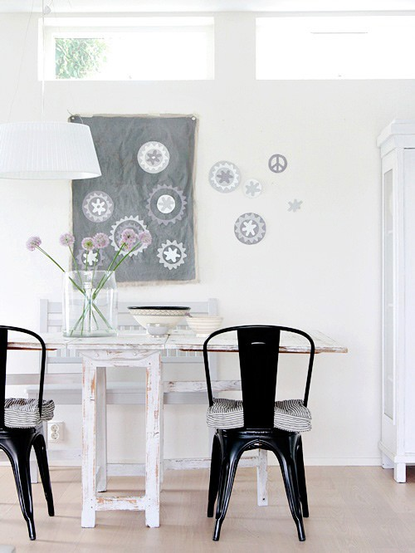
Neutral

Slide 11
Neutral

Slide 12
Accented Neutral
A neutral color scheme with one accent color for interest and variety.

Slide 13
Accented Neutral

Slide 14
Accented Neutral

Slide 15
Accented Neutral

Slide 16
Achromatic
A color scheme using black, white, and/or gray

Slide 17
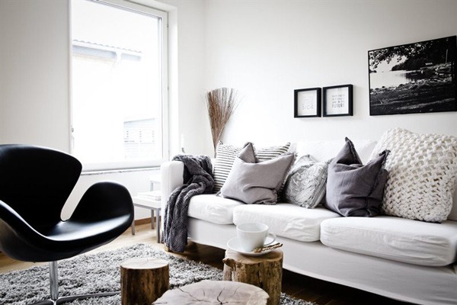
Achromatic

Slide 18
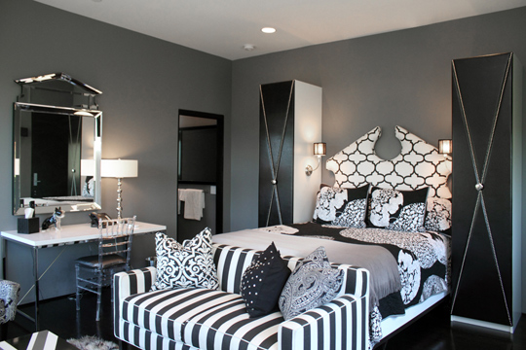
Achromatic

Slide 19
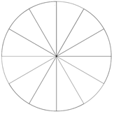
Analogous
Uses 3-5 hues that are next to each other on the color wheel.

Slide 20
Analogous

Slide 21
Analogous

Slide 22
Complimentary
Use hues that are opposite each other on the color wheel
Tends to be a lively color scheme
Use similar values and intensities when combining complementary hues
Has one dominant hue and one accent hue.

Slide 23
Complimentary

Slide 24
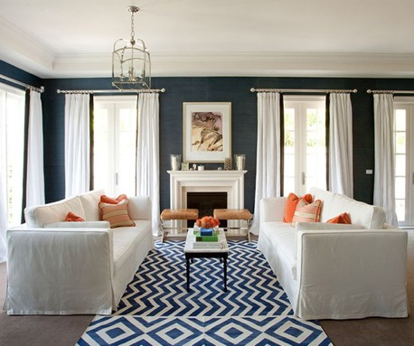
Complimentary

Slide 25
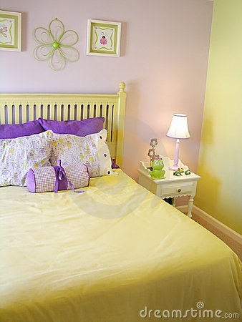
Complimentary

Slide 26
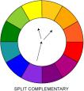
Split –Complementary
Uses a primary color and the two intermediate colors on either side of its complement.
Often found in floral prints or plaids.
Creates strong contrasts in colors
The intermediate hue Blue-violet with hues of yellow and orange

Slide 27
Split Complement
The primary color yellow with accents of blue-violet and red violet in the flower arrangement on the table.

Slide 28
Split Complement
The secondary hue, violet combined with yellow-green and yellow-orange.

Slide 29
Triad
Use three colors evenly spaced on the color wheel.
Usually uses either the primary or secondary colors
Uses a dominant hue, with others for accent

Slide 30
Triad

Slide 31
Triad

Slide 32
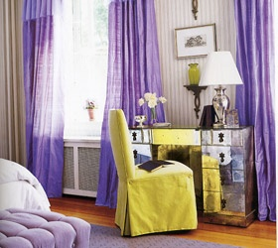
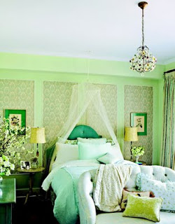
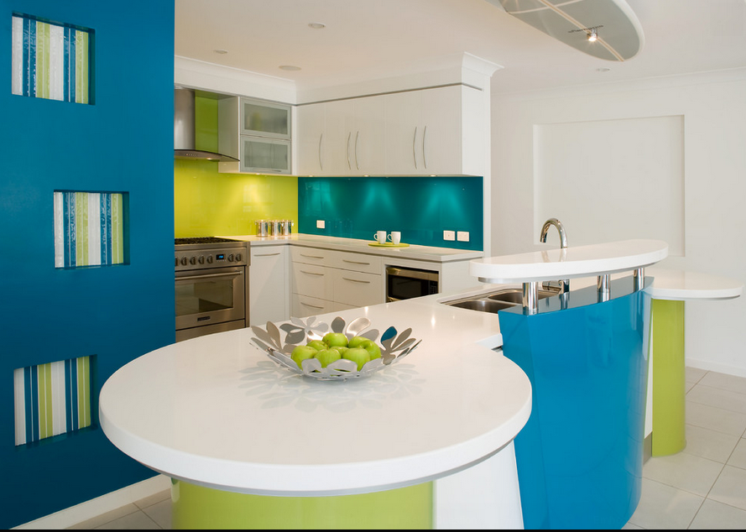
What Color Scheme?
2.
1.
3.
In the left margin on page 48.
Write down your answers.
Notes:
Monochromatic
Complimentary
Analogous

Slide 33
Color scheme identification wheel
Draw a small circle (about 2 inch diameter) with a compass in the center of a piece of card stock
Use protractor to mark every 30 degrees all the way around the outside of the circle
Number the marks 1-12
Draw a line through the center from 1-7
Draw a line from the center to number 5, 6, 8, and 9
Label
“Complimentary” on line 7
“Split” on lines 6 and 8
“Triad” on lines 5 and 9
“Analogous" between 1 and 5
Cut out your circle
Use a brad to attach it to the center of your color wheel. Then glue only the outside of the circle into your notebook. The color scheme wheel should still move when it is glued into the notebook.
1
9
5
8
6
7

Slide 34
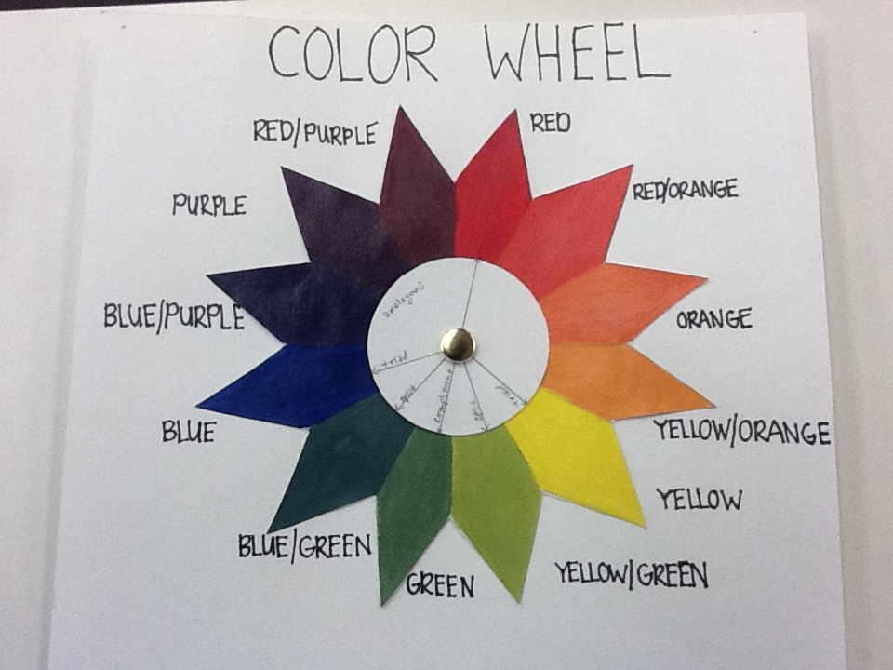

Slide 35
Create your own
You will color 3 rooms in different color schemes from the 8 discussed in class. Follow the directions.
FIRST Identify the color scheme you will be using.
Draw in windows, furniture, and accessories. Design patterns and prints for the floors, rugs, walls, window coverings and furniture.
Decide what colors to use on the walls, furniture, floors, etc.
What feeling do you want this room to have?

Slide 36
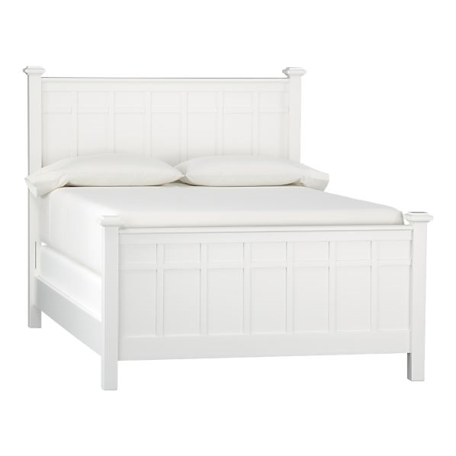
Name___________________________________ Total___/10
Draw in walls, ceiling, floor, furniture, and accessories. Design patterns and prints for the floors, walls, window coverings and furniture. What feeling do you want this room to have?
Color Scheme________________________________
Colors used__________________________________
Feeling you want this room to have_______________________ _________________________________________________________________________________________________
Ceiling
Accent
Wall
Furniture and accessories
Floor

Slide 37
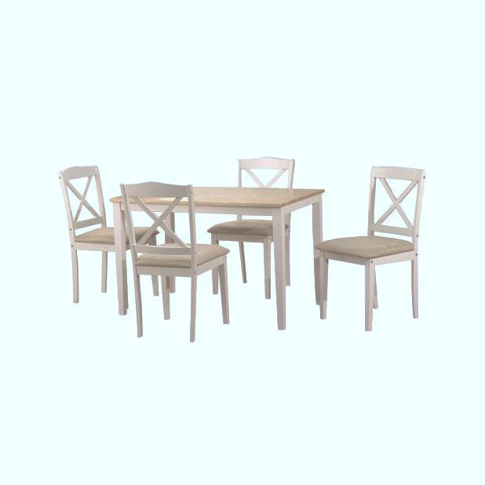
Name___________________________________ Total___/10
Draw in walls, ceiling, floor, furniture, and accessories. Design patterns and prints for the floors, walls, window coverings and furniture. What feeling do you want this room to have?
Color Scheme_________________________________
Colors used__________________________________
Feeling you want this room to have____________________ _________________________________________________________________________________________________
Ceiling
Accent
Wall
Furniture and accessories
15 pts
Floor

Slide 38
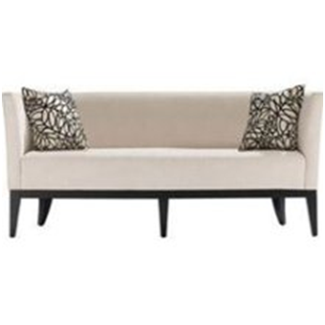
Name___________________________________ Total___/10
Draw in walls, ceiling, floor, furniture, and accessories. Design patterns and prints for the floors, walls, window coverings and furniture. What feeling do you want this room to have?
Color Scheme____________________________________
Colors used______________________________________
Feeling you want this room to have______________________ _________________________________________________________________________________________________
Ceiling
Accent
Wall
Furniture and accessories
Floor

